Slide 1
Econ 645: Week 10-11
Times Series, Serial Correlation, and
A Brief Introduction to Forecasting

Slide 2
Overview
OLS with Times Series
Introduction to OLS with Time Series
Classical Assumptions: Unbiasedness of OLS with Time Series
Time Trends and Seasonality
Goodness-of-Fit
Stationary and Weakly Dependent Time Series
Classical Assumptions: Consistency of OLS with Time Series
Highly Persistent Time Series
Dynamically Complete Models
Serial Correlation in Time Series Regressions
Properties of OLS with Serial Correlation
Testing and Correcting for Serial Correlation
Forecasting

Slide 3
Introduction to OLS with Times Series

Slide 4
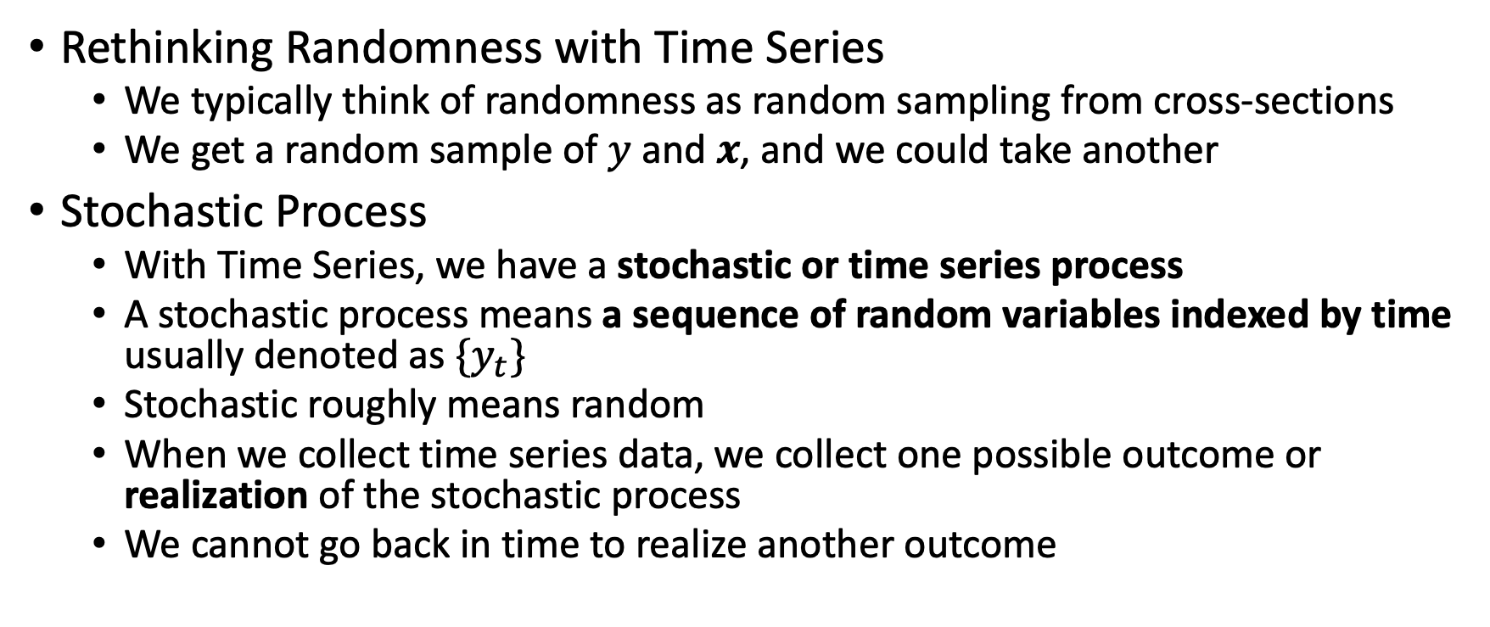
Introduction and Examples
Rethinking Randomness with Time Series
We typically think of randomness as random sampling from cross-sections
We get a random sample of $y$ and $x$, and we could take another
Stochastic Process
With Time Series, we have a stochastic or time series process
A stochastic process means a sequence of random variables indexed by time usually denoted as $\{y_{t}\}$
Stochastic roughly means random
When we collect time series data, we collect one possible outcome or realization of the stochastic process
We cannot go back in time to realize another outcome

Slide 5

Introduction and Examples

Slide 6
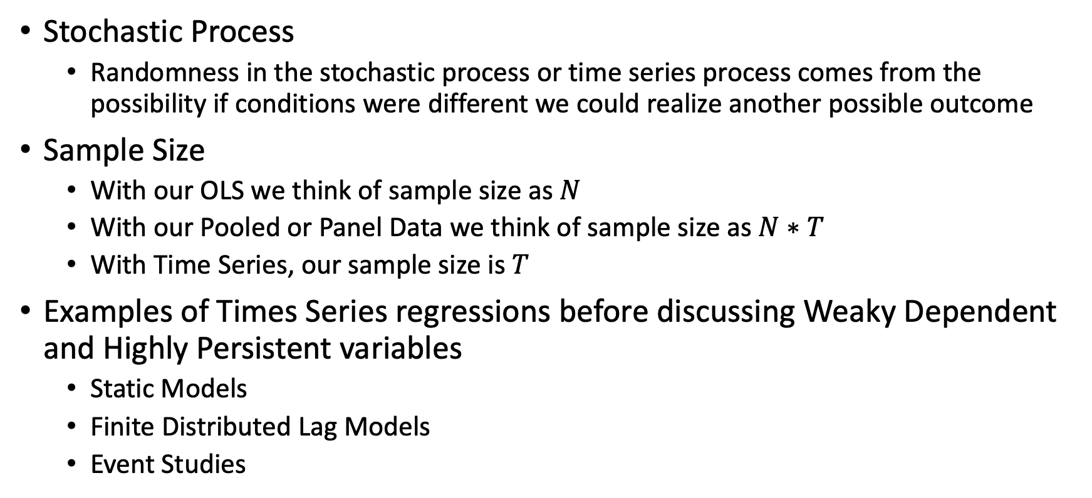
Introduction and Examples
Stochastic Process
Randomness in the stochastic process or time series process comes from the possibility if conditions were different we could realize another possible outcome
Sample Size
With our OLS we think of sample size as $N$
With our Pooled or Panel Data we think of sample size as $N∗T$
With Time Series, our sample size is $T$
Examples of Times Series regressions before discussing Weaky Dependent and Highly Persistent variables
Static Models
Finite Distributed Lag Models
Event Studies

Slide 7
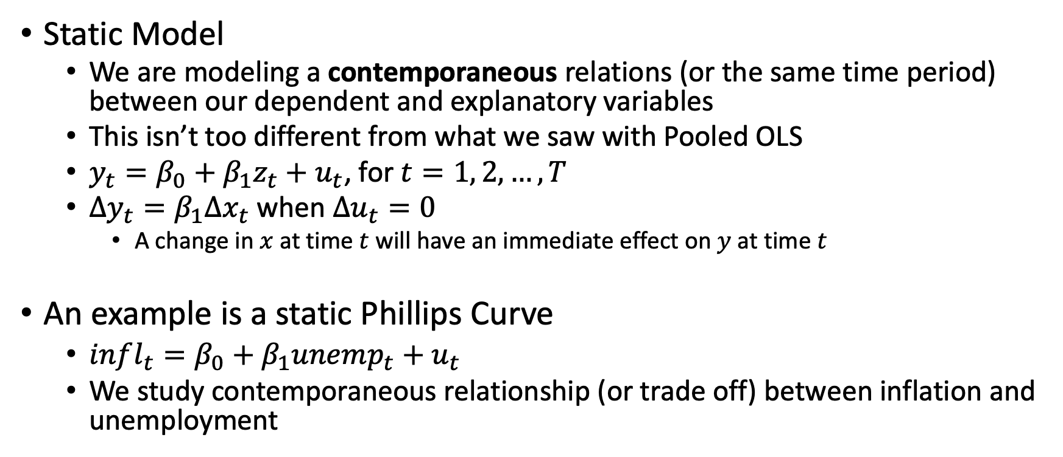
Introduction and Examples
Static Model
We are modeling a contemporaneous relations (or the same time period) between our dependent and explanatory variables
This isn’t too different from what we saw with Pooled OLS
$y_{t}=β_{0}+β_{1}z_{t}+u_{t}$, for $t=1, 2, …, T$
$Δy_{t}=β_{1}Δx_{t}$ when $Δu_{t}=0$
A change in $x$ at time $t$ will have an immediate effect on $y$ at time $t$
An example is a static Phillips Curve
$infl_{t}=β_{0}+β_{1}unemp_{t}+u_{t}$
We study contemporaneous relationship (or trade off) between inflation and unemployment

Slide 8
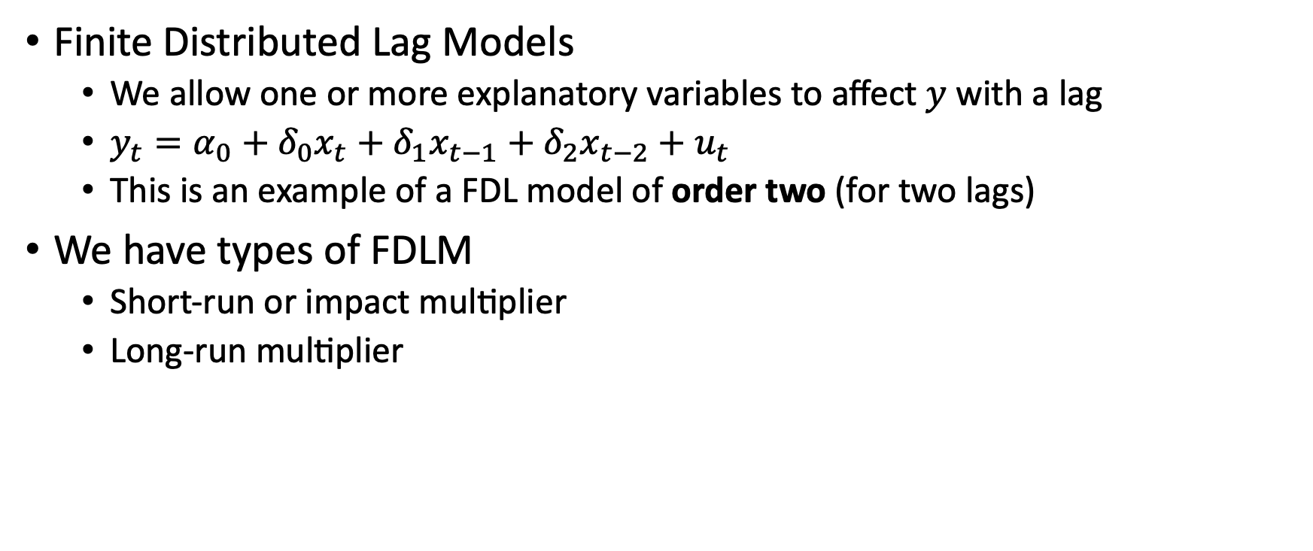
Introduction and Examples
Finite Distributed Lag Models
We allow one or more explanatory variables to affect $y$ with a lag
$y_{t}=α_{0}+δ_{0}x_{t}+δ_{1}x_{t−1}+δ_{2}x_{t−2}+u_{t}$
This is an example of a FDL model of order two (for two lags)
We have types of FDLM
Short-run or impact multiplier
Long-run multiplier

Slide 9
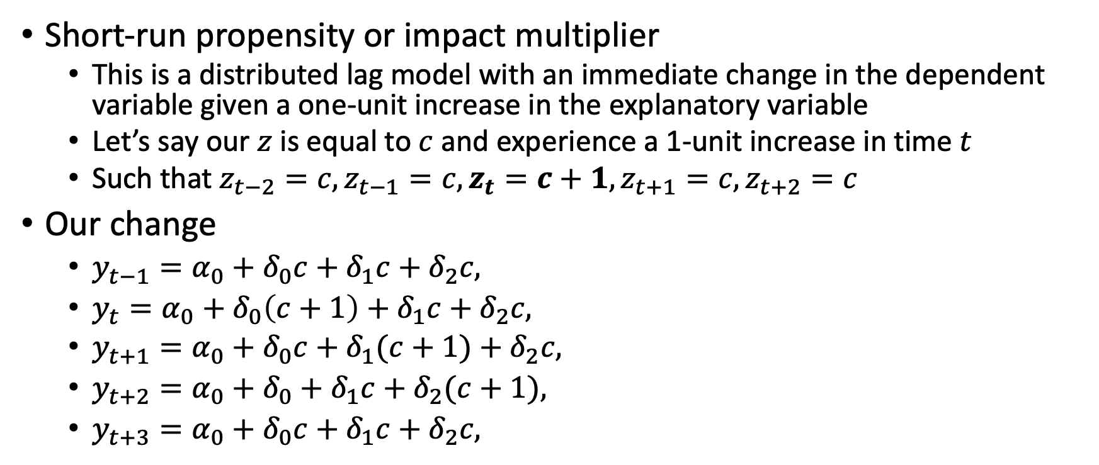
Introduction and Examples
Short-run propensity or impact multiplier
This is a distributed lag model with an immediate change in the dependent variable given a one-unit increase in the explanatory variable
Let’s say our $z$ is equal to $c$ and experience a 1-unit increase in time $t$
Such that $z_{t−2}=c, z_{t−1}=c, z_{t}=c+1, z_{t+1}=c, z_{t+2}=c$
Our change
$y_{t−1}=α_{0}+δ_{0}c+δ_{1}c+δ_{2}c,$
$y_{t}=α_{0}+δ_{0}\left(c+1\right)+δ_{1}c+δ_{2}c,$
$y_{t+1}=α_{0}+δ_{0}c+δ_{1}(c+1)+δ_{2}c,$
$y_{t+2}=α_{0}+δ_{0}+δ_{1}c+δ_{2}(c+1),$
$y_{t+3}=α_{0}+δ_{0}c+δ_{1}c+δ_{2}c,$

Slide 10
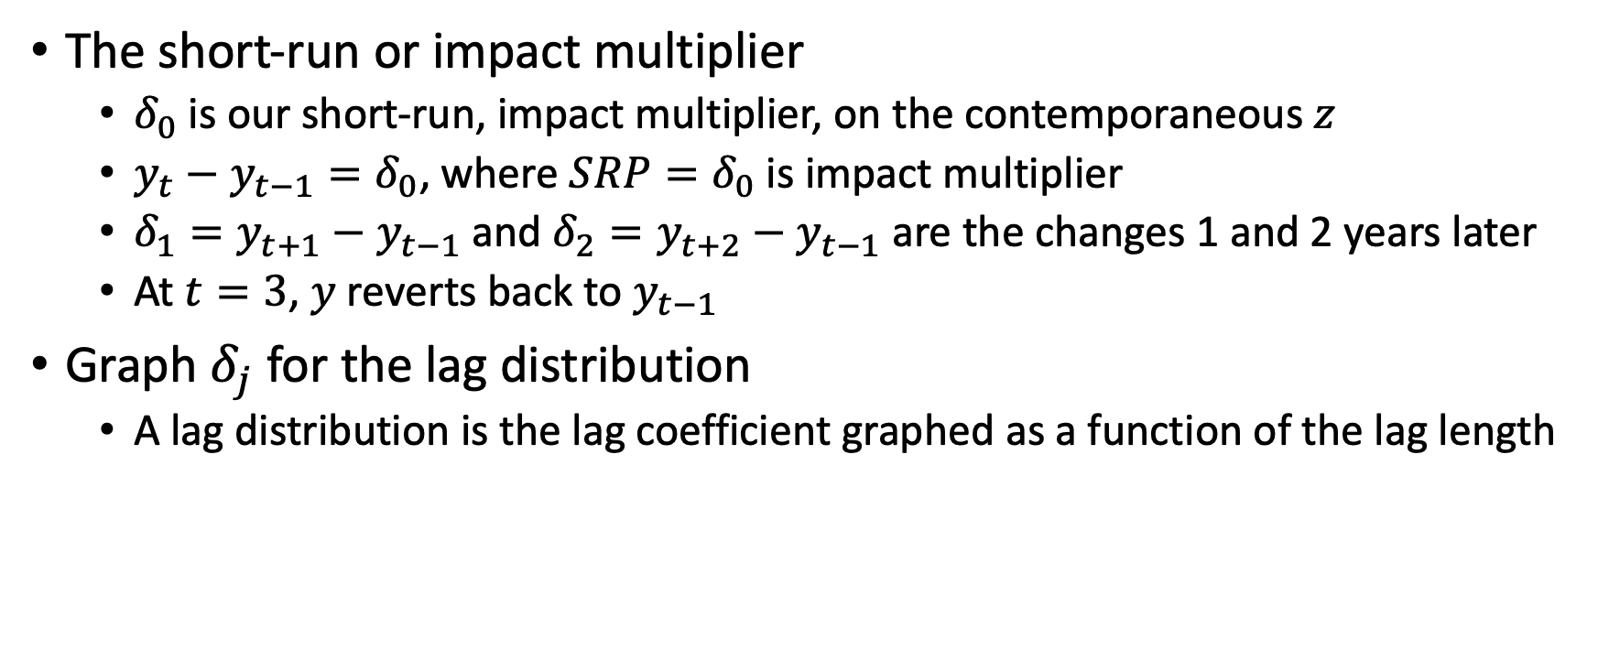
Introduction and Examples
The short-run or impact multiplier
$δ_{0}$ is our short-run, impact multiplier, on the contemporaneous $z$
$y_{t}−y_{t−1}=δ_{0}$, where $SRP=δ_{0}$ is impact multiplier
$δ_{1}=y_{t+1}−y_{t−1}$ and $δ_{2}=y_{t+2}−y_{t−1}$ are the changes 1 and 2 years later
At $t=3$, $y$ reverts back to $y_{t−1}$
Graph $δ_{j}$ for the lag distribution
A lag distribution is the lag coefficient graphed as a function of the lag length

Slide 11
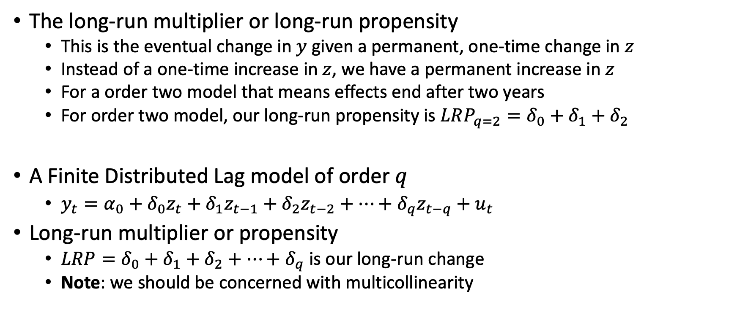
Introduction and Examples
The long-run multiplier or long-run propensity
This is the eventual change in $y$ given a permanent, one-time change in $z$
Instead of a one-time increase in $z$, we have a permanent increase in $z$
For a order two model that means effects end after two years
For order two model, our long-run propensity is $LRP_{q=2}=δ_{0}+δ_{1}+δ_{2}$
A Finite Distributed Lag model of order $q$
$y_{t}=α_{0}+δ_{0}z_{t}+δ_{1}z_{t−1}+δ_{2}z_{t−2}+…+δ_{q}z_{t−q}+u_{t}$
Long-run multiplier or propensity
$LRP=δ_{0}+δ_{1}+δ_{2}+…+δ_{q}$ is our long-run change
Note: we should be concerned with multicollinearity

Slide 12
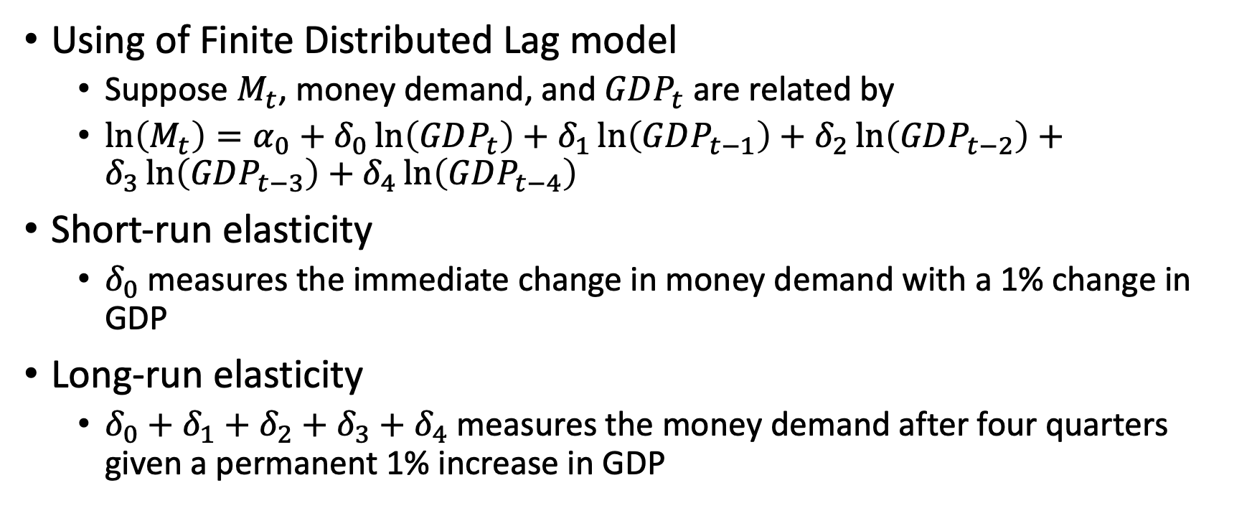
Short-run and Long-run elasticities
Using of Finite Distributed Lag model
Suppose $M_{t}$, money demand, and $GDP_{t}$ are related by
$\ln\left(M_{t}\right)=α_{0}+δ_{0}\ln\left(GDP_{t}\right)+δ_{1}\ln\left(GDP_{t−1}\right)+δ_{2}\ln\left(GDP_{t−2}\right)+δ_{3}\ln\left(GDP_{t−3}\right)+δ_{4}\ln\left(GDP_{t−4}\right)$
Short-run elasticity
$δ_{0}$ measures the immediate change in money demand with a 1% change in GDP
Long-run elasticity
$δ_{0}+δ_{1}+δ_{2}+δ_{3}+δ_{4}$ measures the money demand after four quarters given a permanent 1% increase in GDP
Notes:
The natural log transformation provides interpretations of constant elasticity.
Short-Run Elasticity measures the impact propensity in a distributed lag model when the dependent and independent variables are in log forms
Long-run elasticity measures the long-run propensity in a distributed lag model when the dependent and independent variables arei in log forms; the long-run elasticity is the eventual percentage increase in explained variable given a permanent 1% increase in the explanatory variable.

Slide 13
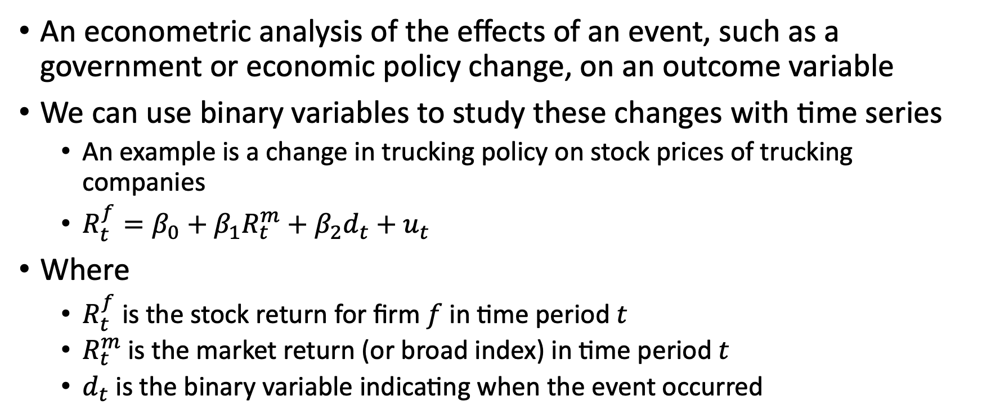
Event Studies
An econometric analysis of the effects of an event, such as a government or economic policy change, on an outcome variable
We can use binary variables to study these changes with time series
An example is a change in trucking policy on stock prices of trucking companies
$R_{t}^{f}=β_{0}+β_{1}R_{t}^{m}+β_{2}d_{t}+u_{t}$
Where
$R_{t}^{f}$ is the stock return for firm $f$ in time period $t$
$R_{t}^{m}$ is the market return (or broad index) in time period $t$
$d_{t}$ is the binary variable indicating when the event occurred
Notes:
Note: we can use index numbers in event studies, where an index looks at rates of change between a current period and a base period $newindex_{t}=100\left(\frac{oldindex_{t}}{oldindex_{base}}\right)$

Slide 14
Classical Assumptions of OLS with Time Series

Slide 15
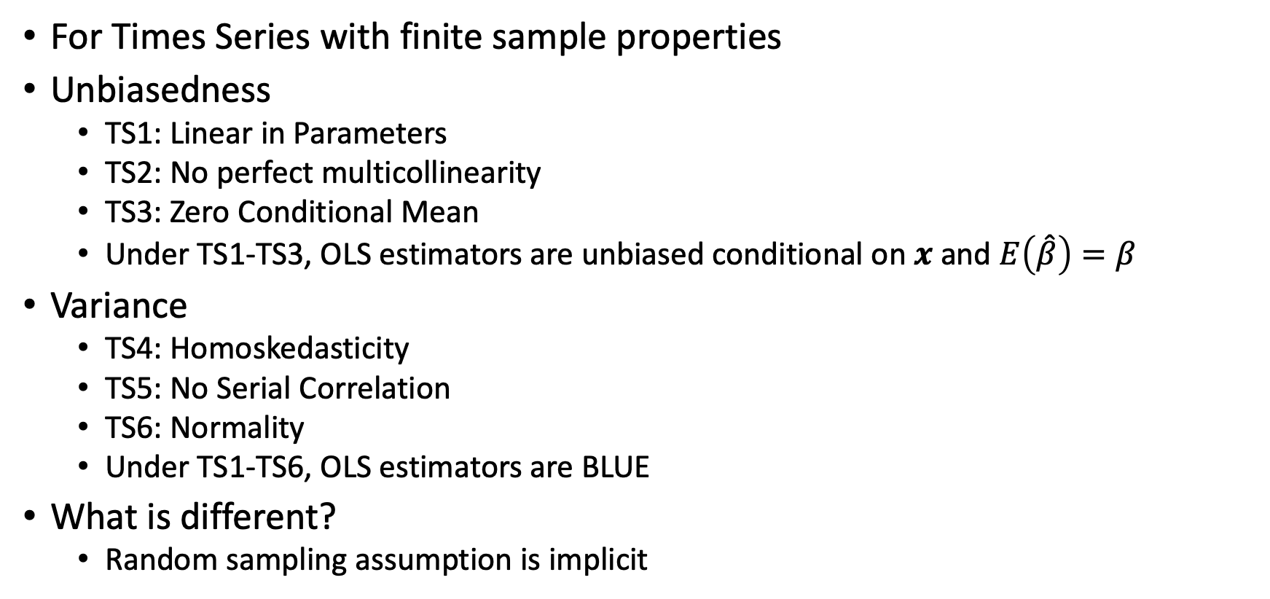
OLS Assumptions with Finite Sample Properties
For Times Series with finite sample properties
Unbiasedness
TS1: Linear in Parameters
TS2: No perfect multicollinearity
TS3: Zero Conditional Mean
Under TS1-TS3, OLS estimators are unbiased conditional on $x$ and $E\left(\hat{β}\right)=β$
Variance
TS4: Homoskedasticity
TS5: No Serial Correlation
TS6: Normality
Under TS1-TS6, OLS estimators are BLUE
What is different?
Random sampling assumption is implicit

Slide 16
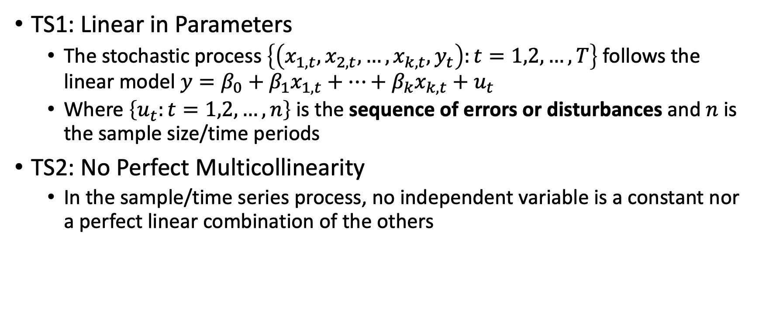
OLS Assumptions with Finite Sample Properties
TS1: Linear in Parameters
The stochastic process $\left\{\left(x_{1,t},x_{2,t},…,x_{k,t},y_{t}\right):t=1,2,…,T\right\}$ follows the linear model $y=β_{0}+β_{1}x_{1,t}+…+β_{k}x_{k,t}+u_{t}$
Where $\left\{u_{t}:t=1,2,…,n\right\}$ is the sequence of errors or disturbances and $n$ is the sample size/time periods
TS2: No Perfect Multicollinearity
In the sample/time series process, no independent variable is a constant nor a perfect linear combination of the others

Slide 17
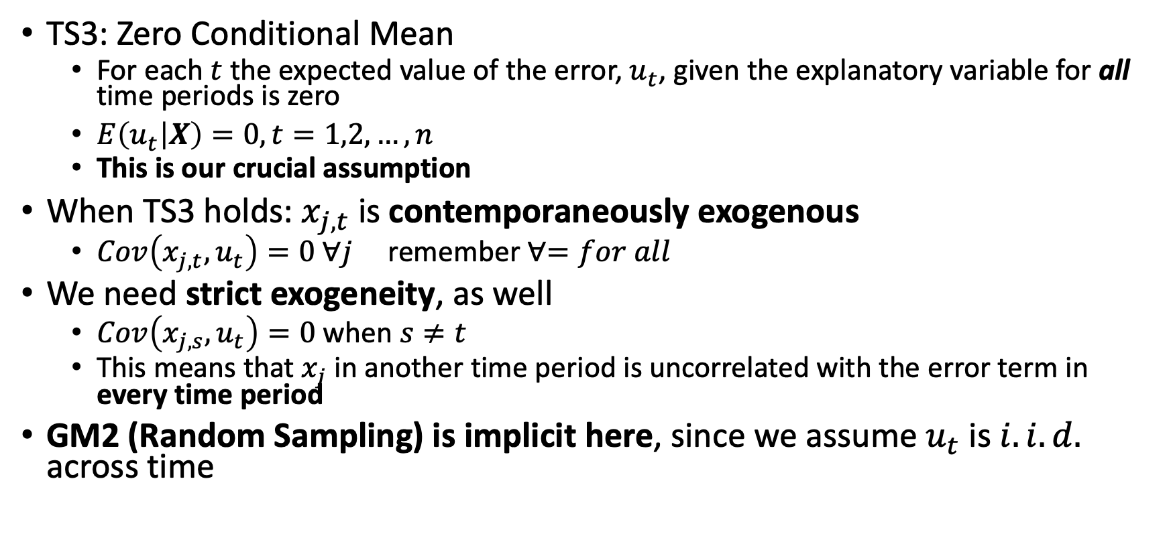
OLS Assumptions with Finite Sample Properties
TS3: Zero Conditional Mean
For each $t$ the expected value of the error, $u_{t}$, given the explanatory variable for all time periods is zero
$E\left(u_{t} | X\right)=0, t=1,2,…,n$
This is our crucial assumption
When TS3 holds: $x_{j,t}$ is contemporaneously exogenous
$Cov\left(x_{j,t},u_{t}\right)=0 ∀j$ remember $∀=for all$
We need strict exogeneity, as well
$Cov\left(x_{j,s},u_{t}\right)=0$ when $s≠t$
This means that $x_{j}$ in another time period is uncorrelated with the error term in every time period
GM2 (Random Sampling) is implicit here, since we assume $u_{t}$ is $i.i.d.$ across time

Slide 18
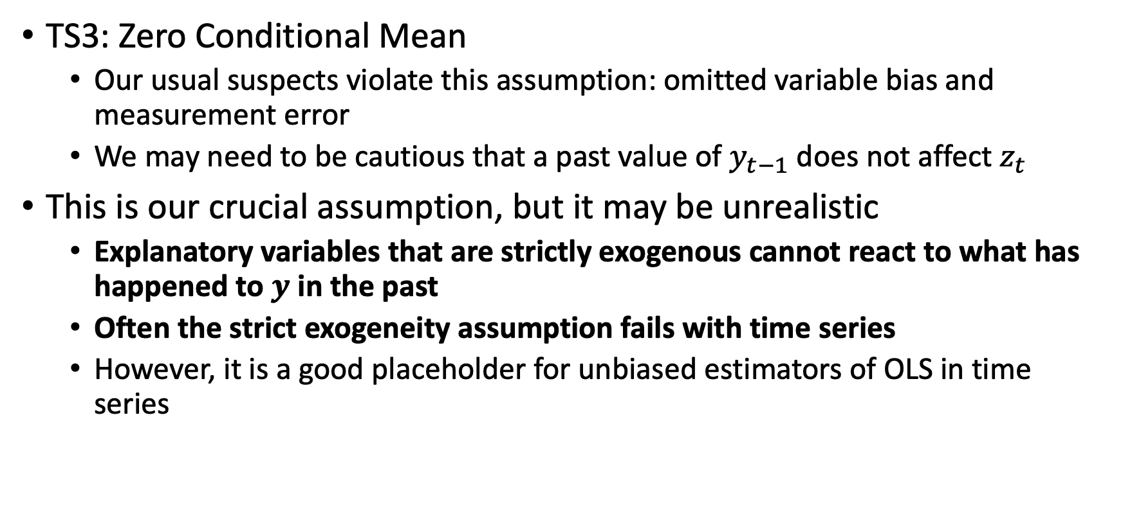
OLS Assumptions with Finite Sample Properties
TS3: Zero Conditional Mean
Our usual suspects violate this assumption: omitted variable bias and measurement error
We may need to be cautious that a past value of $y_{t−1}$ does not affect $z_{t}$
This is our crucial assumption, but it may be unrealistic
Explanatory variables that are strictly exogenous cannot react to what has happened to $y$ in the past
Often the strict exogeneity assumption fails with time series
However, it is a good placeholder for unbiased estimators of OLS in time series

Slide 19
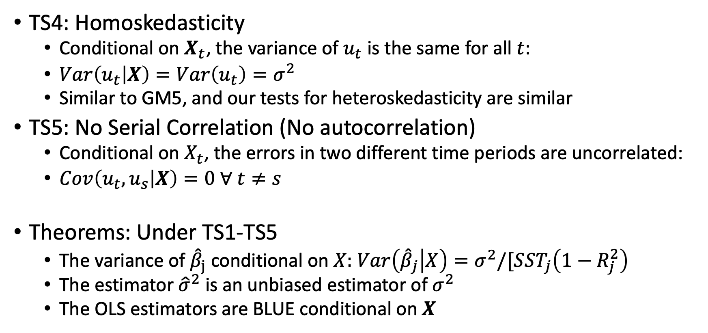
OLS Assumptions with Finite Sample Properties
TS4: Homoskedasticity
Conditional on $X_{t}$, the variance of $u_{t}$ is the same for all $t$:
$Var\left(u_{t} | X\right)=Var\left(u_{t}\right)=σ^{2}$
Similar to GM5, and our tests for heteroskedasticity are similar
TS5: No Serial Correlation (No autocorrelation)
Conditional on $X_{t}$, the errors in two different time periods are uncorrelated:
$Cov\left(u_{t},u_{s} | X\right)=0 ∀ t≠s$
Theorems: Under TS1-TS5
The variance of ${\hat{β}}_{j}$ conditional on $X:$ $Var\left({\hat{β}}_{j} | X\right)=σ^{2}/[SST_{j}\left(1−R_{j}^{2}\right)$
The estimator ${\hat{σ}}^{2}$ is an unbiased estimator of $σ^{2}$
The OLS estimators are BLUE conditional on $X$
Notes:
Note: TS5 says nothing about temporal correlation within $X$, such that we expect inflation to be correlated with prior time periods of inflation.
Note: We do not need to worry about serial correlation with cross-sections, since random sampling means are i.i.d.

Slide 20
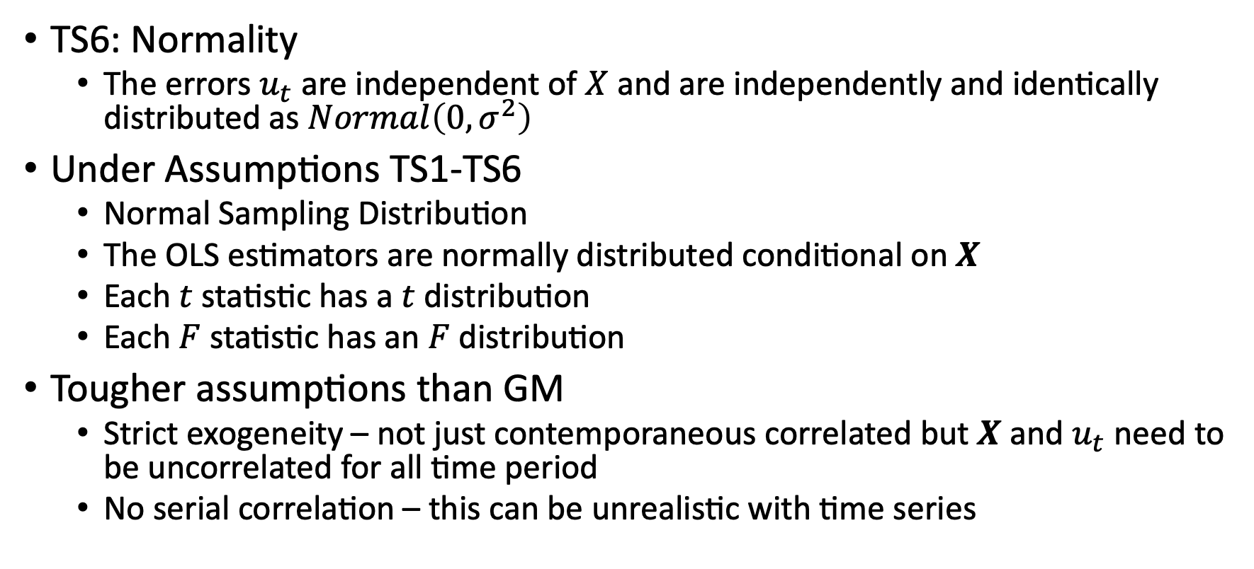
OLS Assumptions with Finite Sample Properties
TS6: Normality
The errors $u_{t}$ are independent of $X$ and are independently and identically distributed as $Normal\left(0,σ^{2}\right)$
Under Assumptions TS1-TS6
Normal Sampling Distribution
The OLS estimators are normally distributed conditional on $X$
Each $t$ statistic has a $t$ distribution
Each $F$ statistic has an $F$ distribution
Tougher assumptions than GM
Strict exogeneity – not just contemporaneous correlated but $X$ and $u_{t}$ need to be uncorrelated for all time period
No serial correlation – this can be unrealistic with time series

Slide 21
Time Trends and Seasonality

Slide 22
Time Trends and Seasonality
Some times series contain time trends
A time trend is a function of time that is the expected value of a trending time series process
We need to account for the time trend in order to draw appropriate conclusions
Omitting a time trend is similar to omitted variable bias
How do we capture or account for these time trends?
Linear Time Trend
Exponential Time Trend

Slide 23
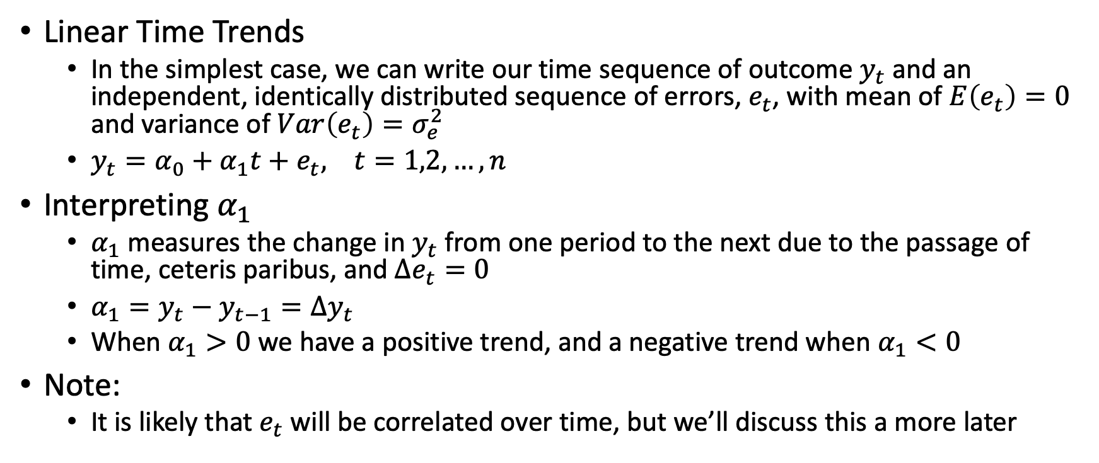
Time Trends
Linear Time Trends
In the simplest case, we can write our time sequence of outcome $y_{t}$ and an independent, identically distributed sequence of errors, $e_{t}$, with mean of $E\left(e_{t}\right)=0$ and variance of $Var\left(e_{t}\right)=σ_{e}^{2}$
$y_{t}=α_{0}+α_{1}t+e_{t}, t=1,2,…,n$
Interpreting $α_{1}$
$α_{1}$ measures the change in $y_{t}$ from one period to the next due to the passage of time, ceteris paribus, and $Δe_{t}=0$
$α_{1}=y_{t}−y_{t−1}=Δy_{t}$
When $α_{1}>0$ we have a positive trend, and a negative trend when $α_{1}<0$
Note:
It is likely that $e_{t}$ will be correlated over time, but we’ll discuss this a more later

Slide 24
Time Trends

Slide 25
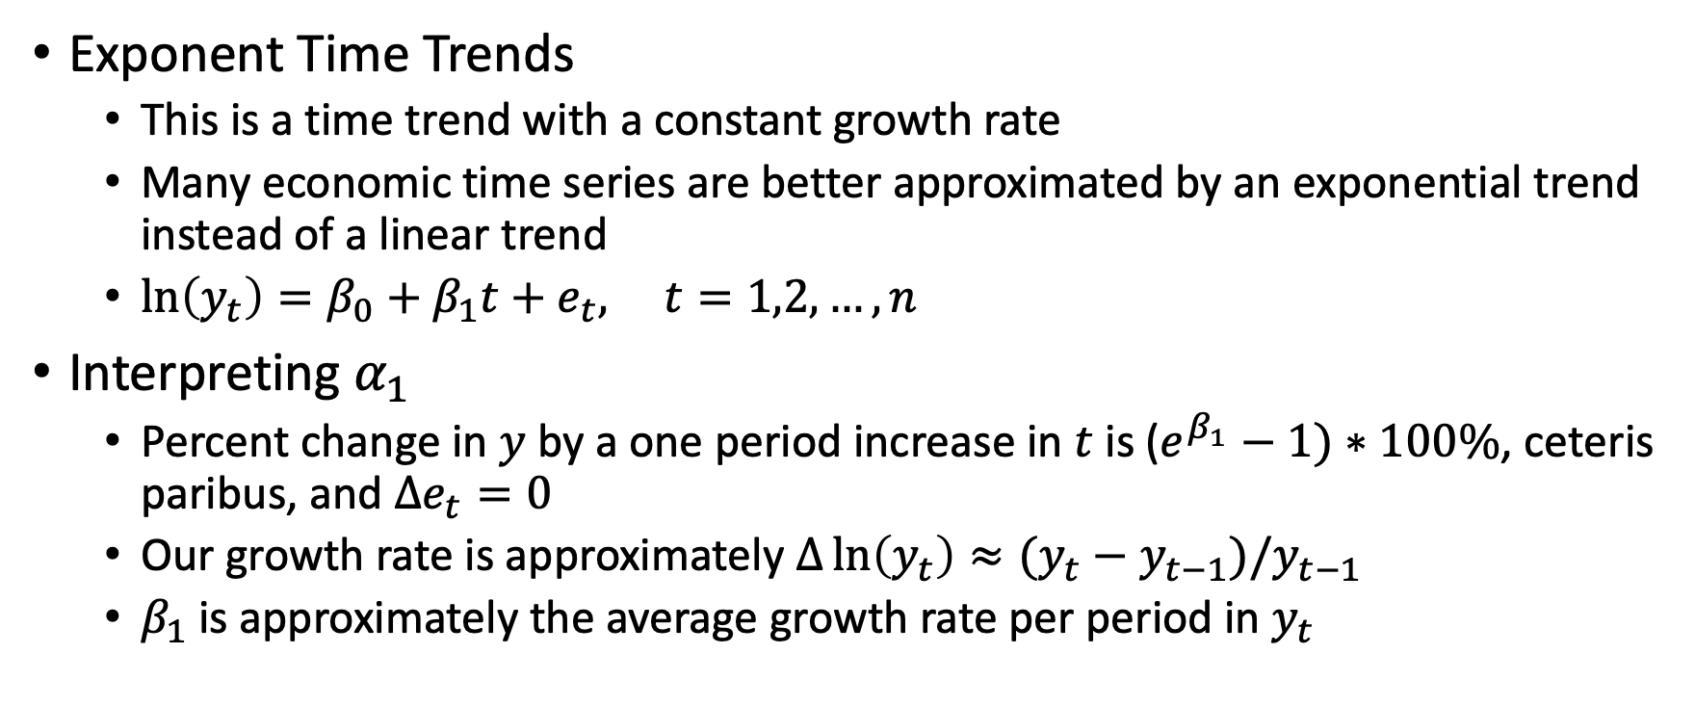
Time Trends
Exponent Time Trends
This is a time trend with a constant growth rate
Many economic time series are better approximated by an exponential trend instead of a linear trend
$\ln\left(y_{t}\right)=β_{0}+β_{1}t+e_{t}, t=1,2,…,n$
Interpreting $α_{1}$
Percent change in $y$ by a one period increase in $t$ is ($e^{β_{1}}−1)∗100\%$, ceteris paribus, and $Δe_{t}=0$
Our growth rate is approximately $Δ\ln\left(y_{t}\right)≈(y_{t}−y_{t−1})/y_{t−1}$
$β_{1}$ is approximately the average growth rate per period in $y_{t}$

Slide 26
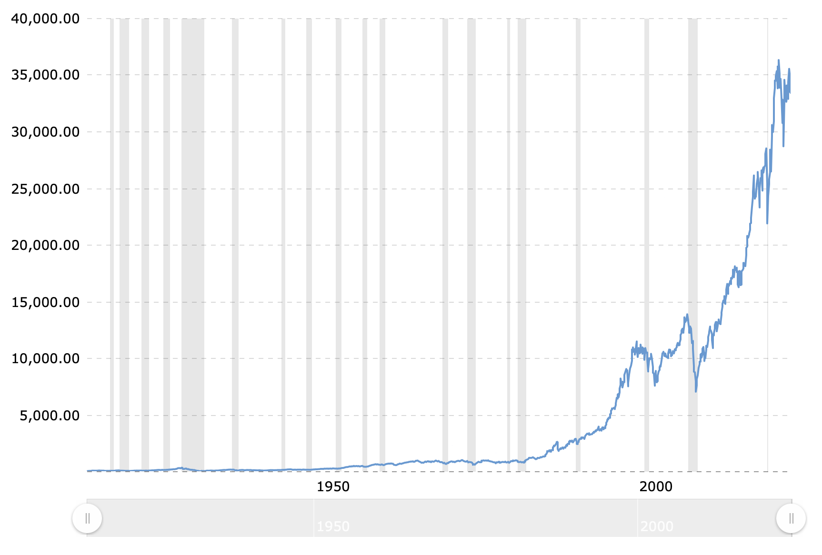
Time Trends
Exponential Example: Dow Jones Index Growth over time

Slide 27
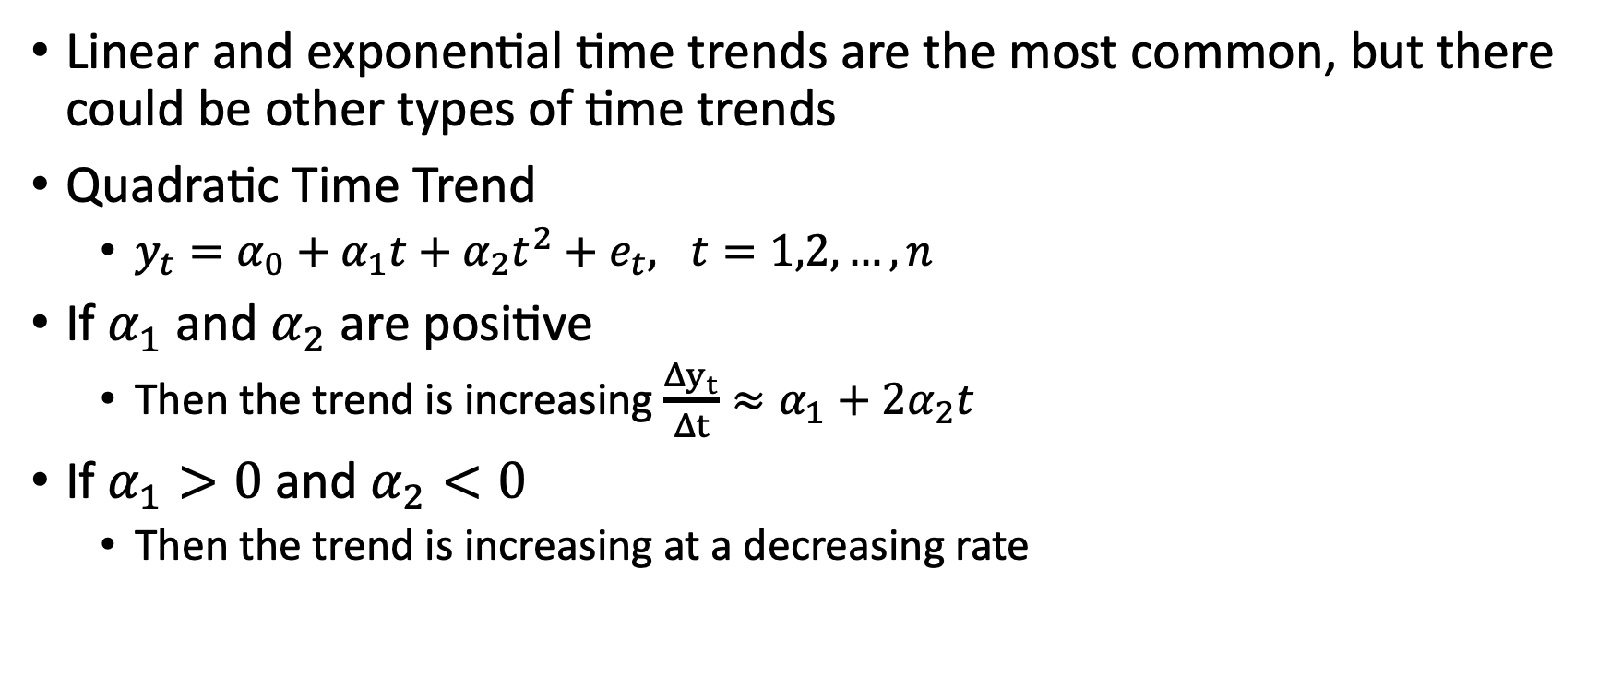
Time Trends
Linear and exponential time trends are the most common, but there could be other types of time trends
Quadratic Time Trend
$y_{t}=α_{0}+α_{1}t+α_{2}t^{2}+e_{t}, t=1,2,…,n$
If $α_{1}$ and $α_{2}$ are positive
Then the trend is increasing $\frac{Δy_{t}}{Δt}≈α_{1}+2α_{2}t$
If $α_{1}>0$and $α_{2}<0$
Then the trend is increasing at a decreasing rate

Slide 28
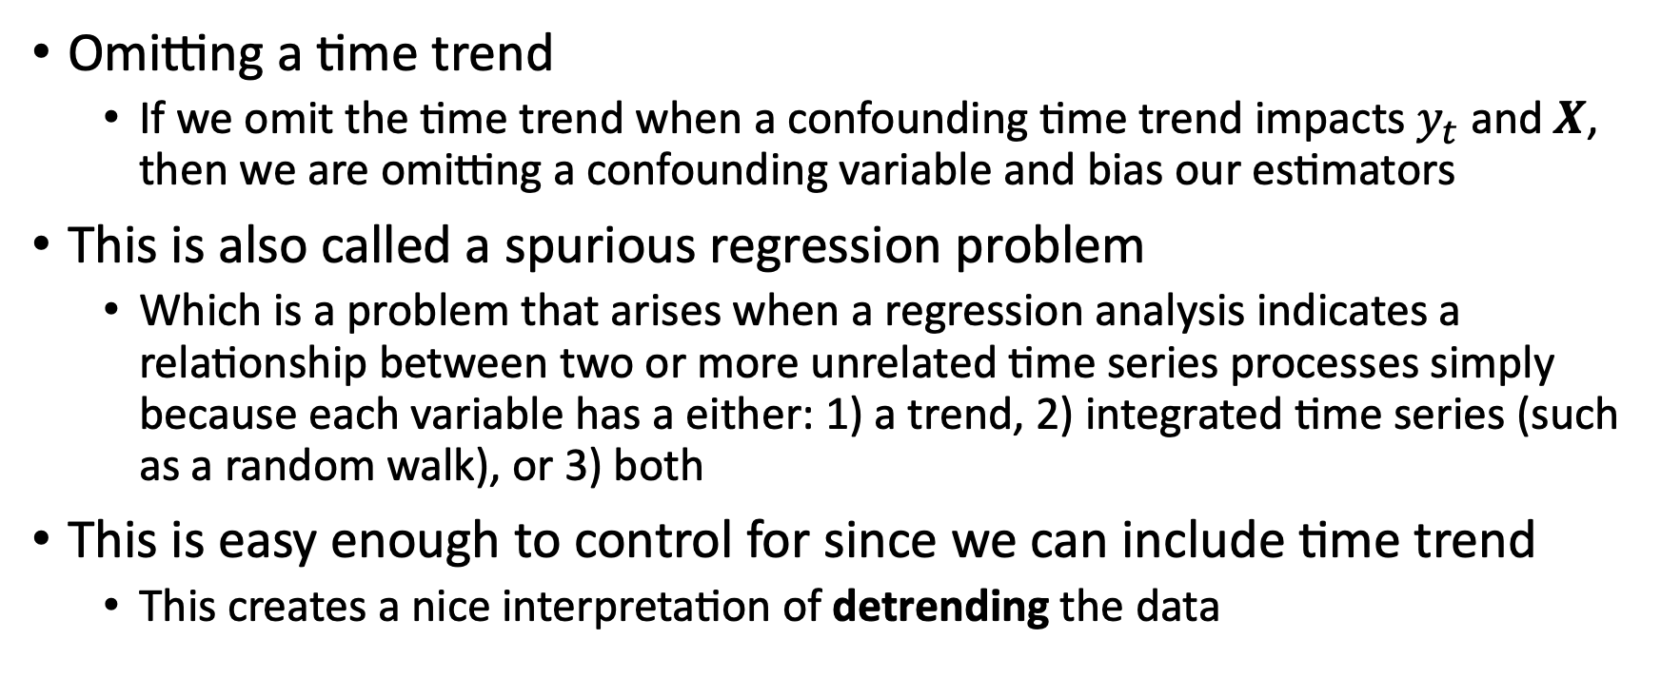
Time Trends
Omitting a time trend
If we omit the time trend when a confounding time trend impacts $y_{t}$ and $X$, then we are omitting a confounding variable and bias our estimators
This is also called a spurious regression problem
Which is a problem that arises when a regression analysis indicates a relationship between two or more unrelated time series processes simply because each variable has a either: 1) a trend, 2) integrated time series (such as a random walk), or 3) both
This is easy enough to control for since we can include time trend
This creates a nice interpretation of detrending the data

Slide 29
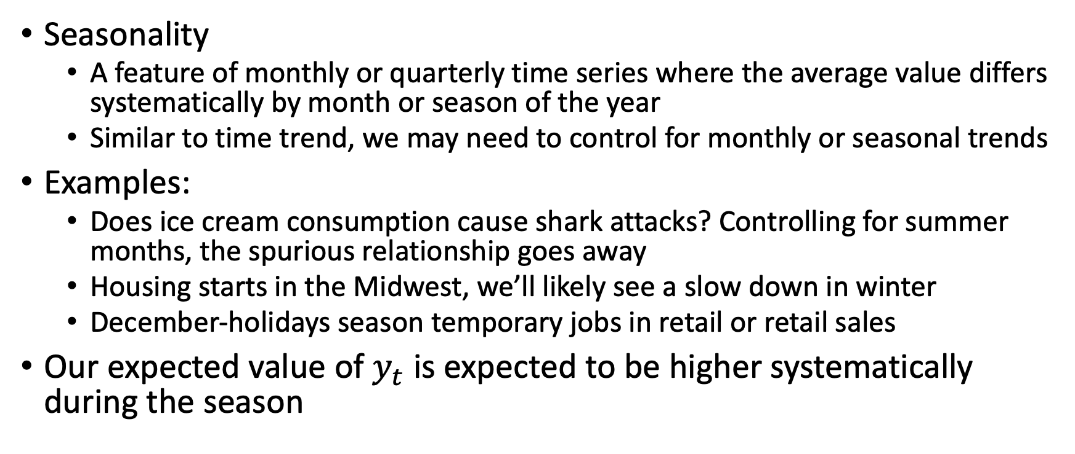
Seasonality
Seasonality
A feature of monthly or quarterly time series where the average value differs systematically by month or season of the year
Similar to time trend, we may need to control for monthly or seasonal trends
Examples:
Does ice cream consumption cause shark attacks? Controlling for summer months, the spurious relationship goes away
Housing starts in the Midwest, we’ll likely see a slow down in winter
December-holidays season temporary jobs in retail or retail sales
Our expected value of $y_{t}$ is expected to be higher systematically during the season

Slide 30
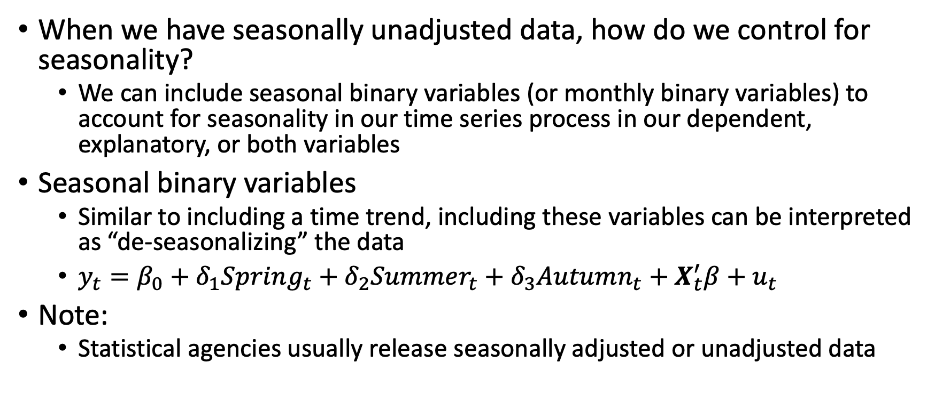
Seasonality
When we have seasonally unadjusted data, how do we control for seasonality?
We can include seasonal binary variables (or monthly binary variables) to account for seasonality in our time series process in our dependent, explanatory, or both variables
Seasonal binary variables
Similar to including a time trend, including these variables can be interpreted as “de-seasonalizing” the data
$y_{t}=β_{0}+δ_{1}Spring_{t}+δ_{2}Summer_{t}+δ_{3}Autumn_{t}+X_{t}^{′}β+u_{t}$
Note:
Statistical agencies usually release seasonally adjusted or unadjusted data

Slide 31
Goodness-of-Fit

Slide 32
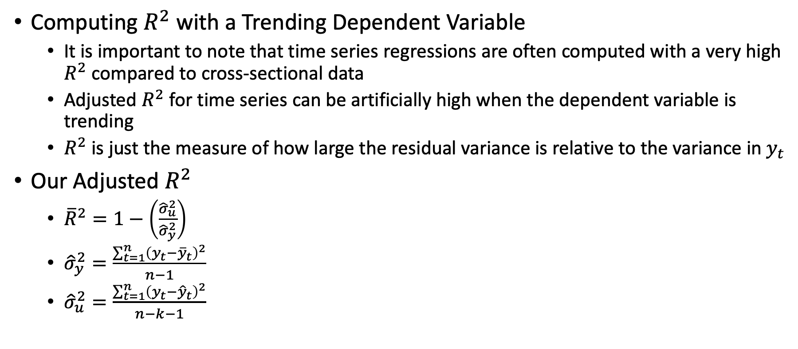
Goodness of Fit with Time Series
Computing $R^{2}$ with a Trending Dependent Variable
It is important to note that time series regressions are often computed with a very high $R^{2}$ compared to cross-sectional data
Adjusted $R^{2}$ for time series can be artificially high when the dependent variable is trending
$R^{2}$ is just the measure of how large the residual variance is relative to the variance in $y_{t}$
Our Adjusted $R^{2}$
${\overline{R}}^{2}=1−\left(\frac{{\hat{σ}}_{u}^{2}}{{\hat{σ}}_{y}^{2}}\right)$
${\hat{σ}}_{y}^{2}=\frac{\sum_{t=1}^{n}{{\left(y_{t}−{\overline{y}}_{t}\right)}^{2}}}{n−1}$
${\hat{σ}}_{u}^{2}=\frac{\sum_{t=1}^{n}{{\left(y_{t}−{\hat{y}}_{t}\right)}^{2}}}{n−k−1}$

Slide 33
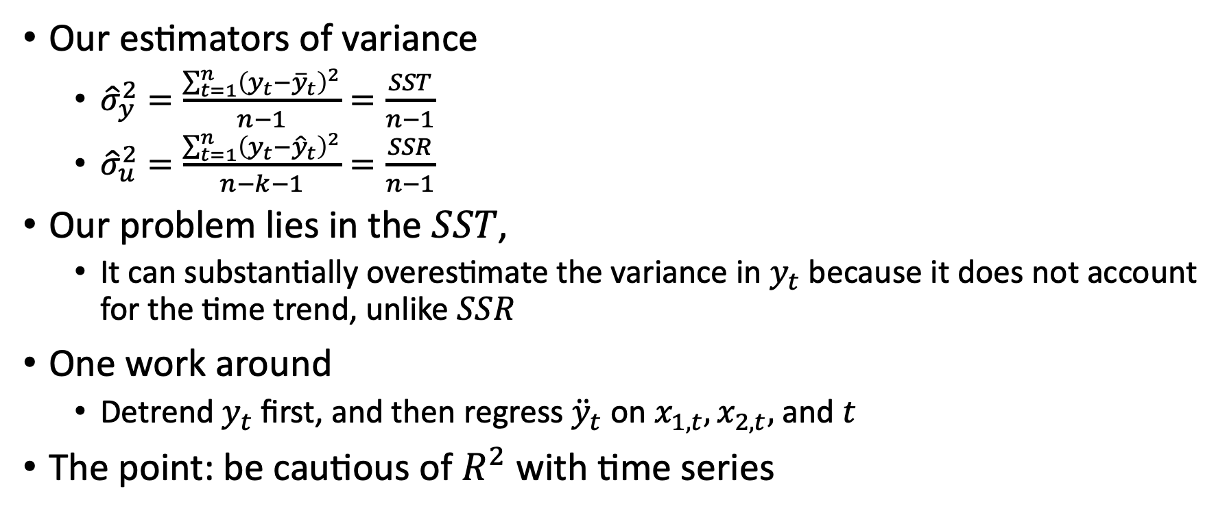
Goodness of Fit with Time Series
Our estimators of variance
${\hat{σ}}_{y}^{2}=\frac{\sum_{t=1}^{n}{{\left(y_{t}−{\overline{y}}_{t}\right)}^{2}}}{n−1}=\frac{SST}{n−1}$
${\hat{σ}}_{u}^{2}=\frac{\sum_{t=1}^{n}{{\left(y_{t}−{\hat{y}}_{t}\right)}^{2}}}{n−k−1}=\frac{SSR}{n−1}$
Our problem lies in the $SST$,
It can substantially overestimate the variance in $y_{t}$ because it does not account for the time trend, unlike $SSR$
One work around
Detrend $y_{t}$ first, and then regress ${\ddot{y}}_{t}$ on $x_{1,t}, x_{2,t},$ and $t$
The point: be cautious of $R^{2}$ with time series

Slide 34
Stationary and Weakly Dependent Time Series

Slide 35
Stationary and Weakly Dependent
We will likely have biased estimators using OLS with time series
However, we can have consistent estimators using OLS with time series
We need a few essential features
We need large samples
We need stable or stationary time series
We need weak dependence in the time series

Slide 36
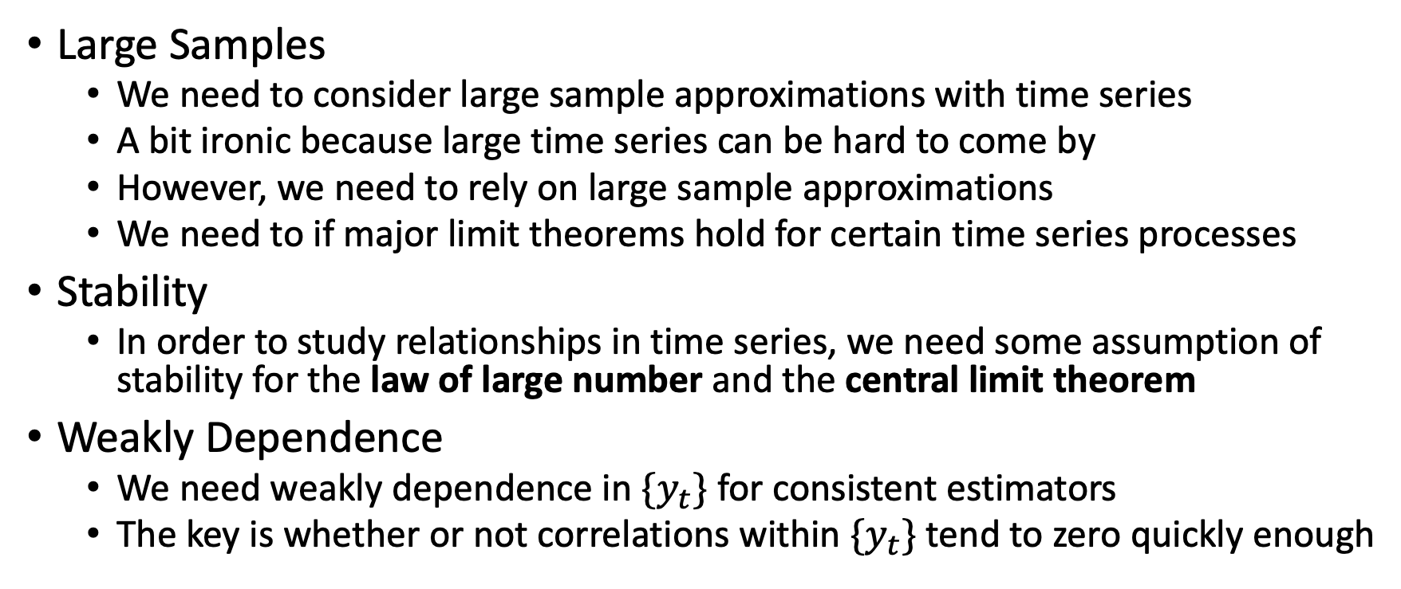
Stationary and Weakly Dependent
Large Samples
We need to consider large sample approximations with time series
A bit ironic because large time series can be hard to come by
However, we need to rely on large sample approximations
We need to if major limit theorems hold for certain time series processes
Stability
In order to study relationships in time series, we need some assumption of stability for the law of large number and the central limit theorem
Weakly Dependence
We need weakly dependence in $\{y_{t}\}$ for consistent estimators
The key is whether or not correlations within $\{y_{t}\}$ tend to zero quickly enough

Slide 37
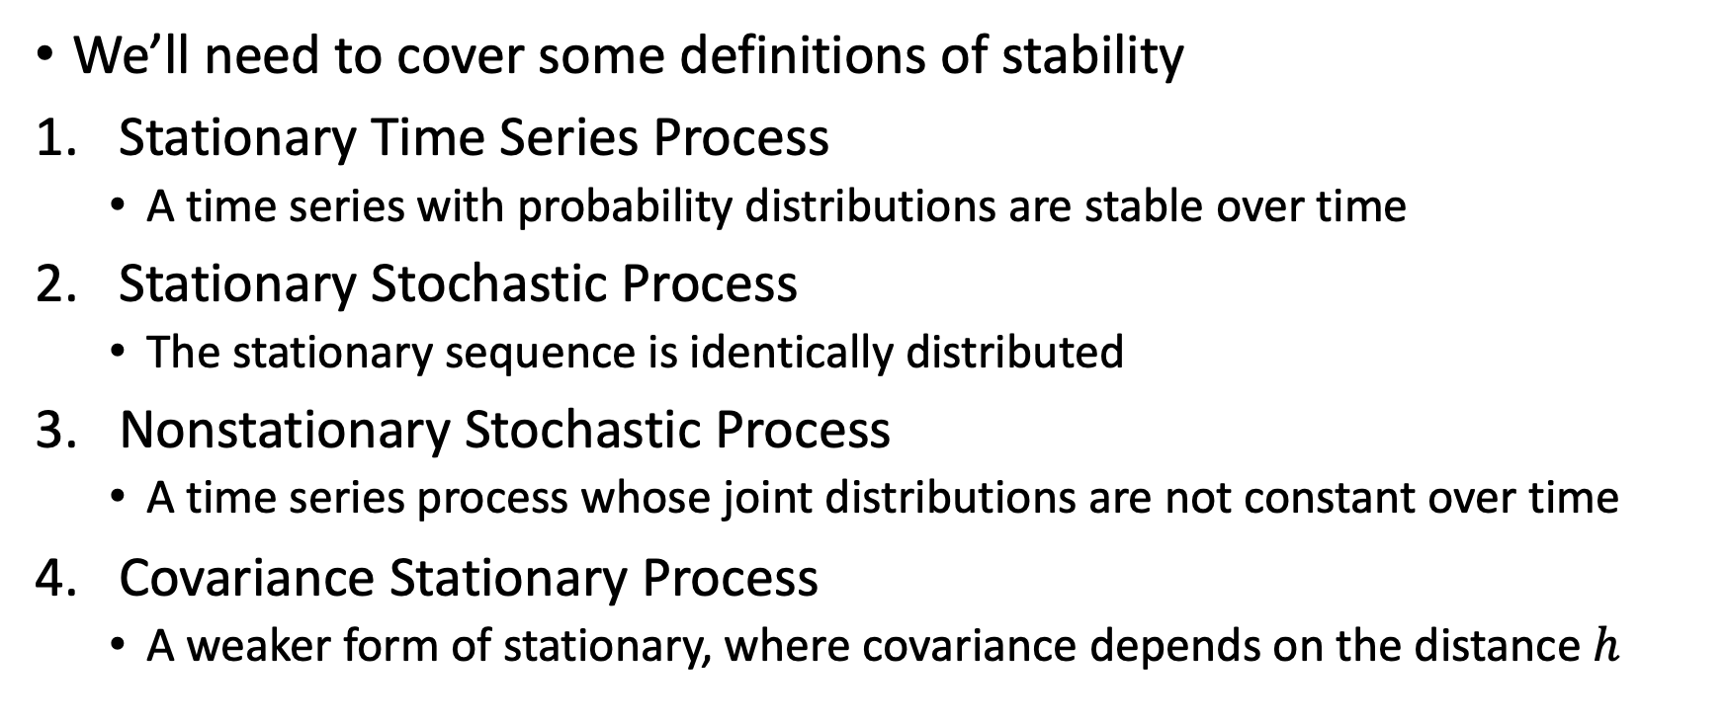
Stationary and Weakly Dependent
We’ll need to cover some definitions of stability
Stationary Time Series Process
A time series with probability distributions are stable over time
Stationary Stochastic Process
The stationary sequence is identically distributed
Nonstationary Stochastic Process
A time series process whose joint distributions are not constant over time
Covariance Stationary Process
A weaker form of stationary, where covariance depends on the distance $h$

Slide 38
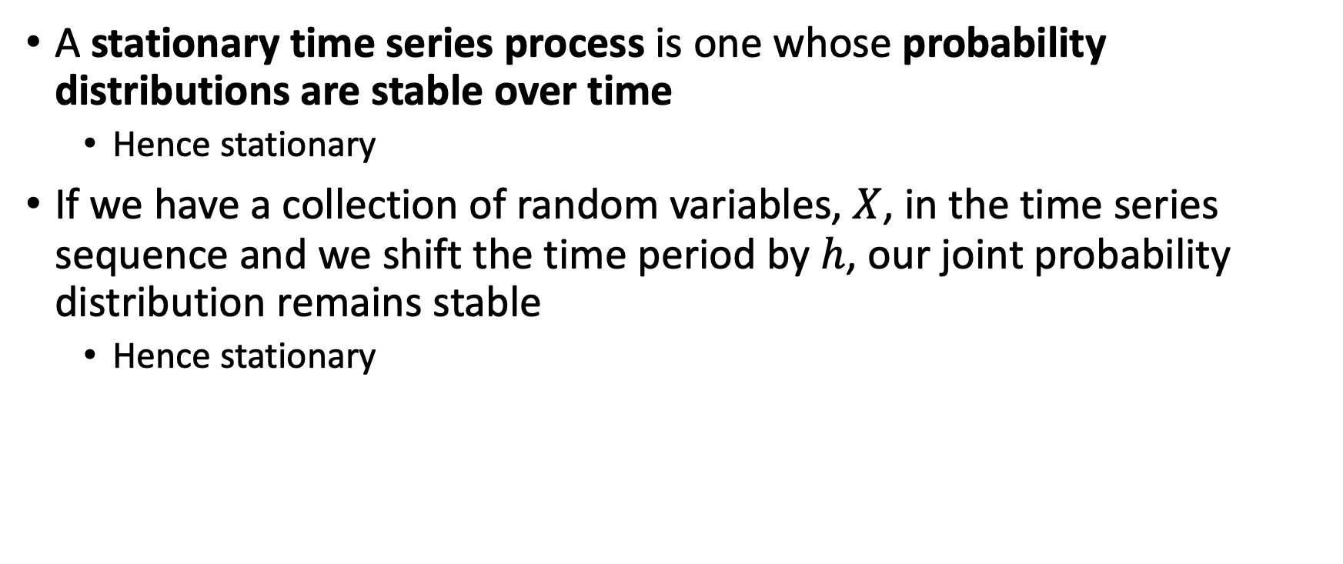
Stationary Process
A stationary time series process is one whose probability distributions are stable over time
Hence stationary
If we have a collection of random variables, $X$, in the time series sequence and we shift the time period by $h$, our joint probability distribution remains stable
Hence stationary

Slide 39
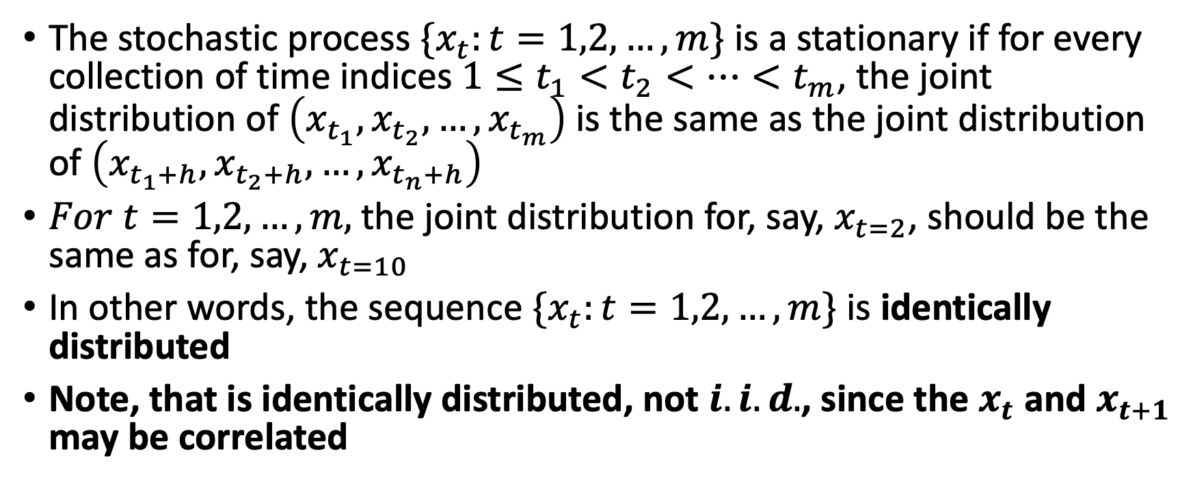
Stationary Stochastic Process
The stochastic process $\{x_{t}:t=1,2,…,m\}$ is a stationary if for every collection of time indices $1≤t_{1}<t_{2}<…<t_{m}$, the joint distribution of $\left(x_{t_{1}},x_{t_{2}},…,x_{t_{m}}\right)$ is the same as the joint distribution of $\left(x_{t_{1}+h},x_{t_{2}+h},…,x_{t_{n}+h}\right)$
$For t=1,2,…,m,$the joint distribution for, say, $x_{t=2}$, should be the same as for, say, $x_{t=10}$
In other words, the sequence $\{x_{t}:t=1,2,…,m\}$ is identically distributed
Note, that is identically distributed, not $i.i.d.$, since the $x_{t}$ and $x_{t+1}$ may be correlated

Slide 40
Nonstationary Stochastic Process
A time series process whose joint distributions are not constant across different epochs/periods
A process with a time trend is clearly nonstationary, since it’s joint distribution (and mean) change over time

Slide 41
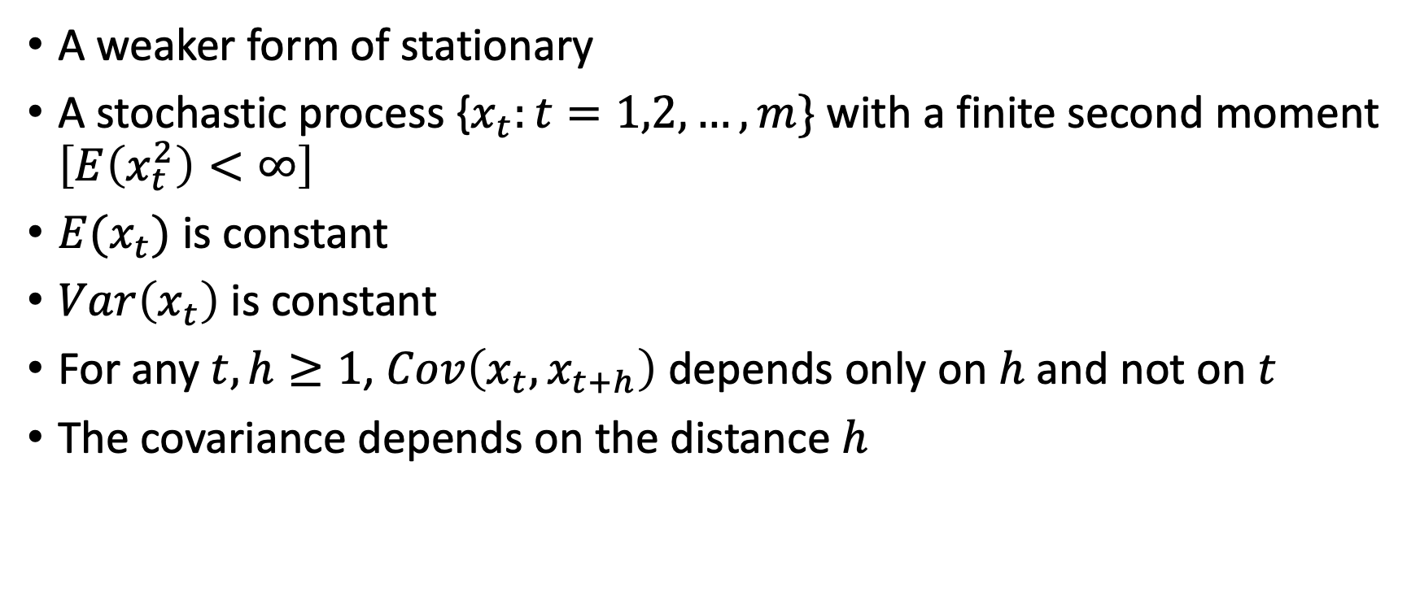
Covariance Stationary Process
A weaker form of stationary
A stochastic process {$x_{t}:t=1,2,…,m\}$ with a finite second moment $\left[E\left(x_{t}^{2}\right)<∞\right]$
$E(x_{t})$ is constant
$Var\left(x_{t}\right)$ is constant
For any $t, h≥1$, $Cov\left(x_{t},x_{t+h}\right)$ depends only on $h$ and not on $t$
The covariance depends on the distance $h$

Slide 42
Why do we care about stationary?
It simplifies statements of the Law of Large Numbers and Central Limit Theorem
We need to assume some sort of stability over time to understand the relationship between two or more variables
Stationary deals with stability in the joint probability distribution as the time series process moves through time

Slide 43
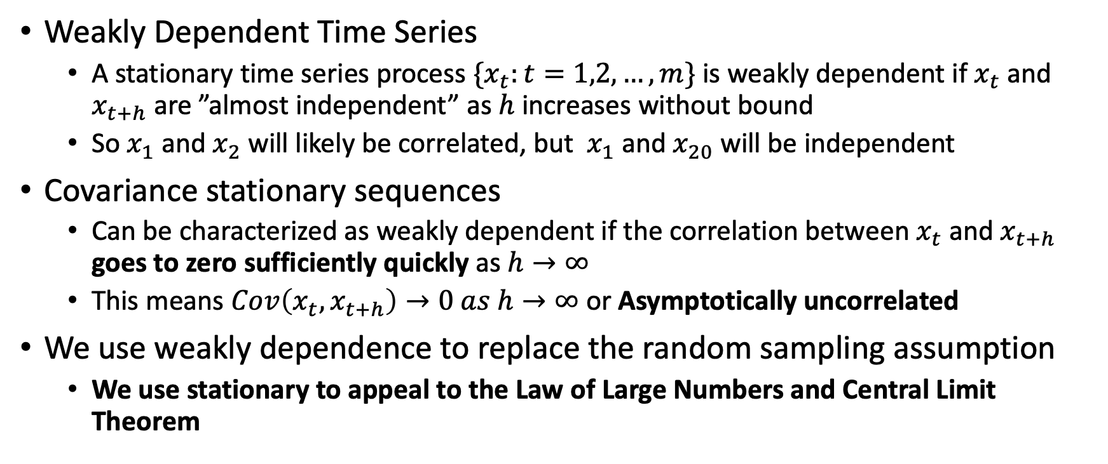
Stationary and Weakly Dependent
Weakly Dependent Time Series
A stationary time series process $\{x_{t}:t=1,2,…,m\}$ is weakly dependent if $x_{t}$ and $x_{t+h}$ are ”almost independent” as $h$ increases without bound
So $x_{1}$ and $x_{2}$ will likely be correlated, but $x_{1}$ and $x_{20}$ will be independent
Covariance stationary sequences
Can be characterized as weakly dependent if the correlation between $x_{t}$ and $x_{t+h}$ goes to zero sufficiently quickly as $h→∞$
This means $Cov\left(x_{t},x_{t+h}\right)→0 as h→∞$ or Asymptotically uncorrelated
We use weakly dependence to replace the random sampling assumption
We use stationary to appeal to the Law of Large Numbers and Central Limit Theorem
Notes:
Covariance stationary sequences can be characterized in terms of correlations: a covariance stationary times series is weakly dependent if the correlation between $x_{t}$ and $x_{t+h}$ goes to zero sufficiently quickly as $h→ ∞$

Slide 44
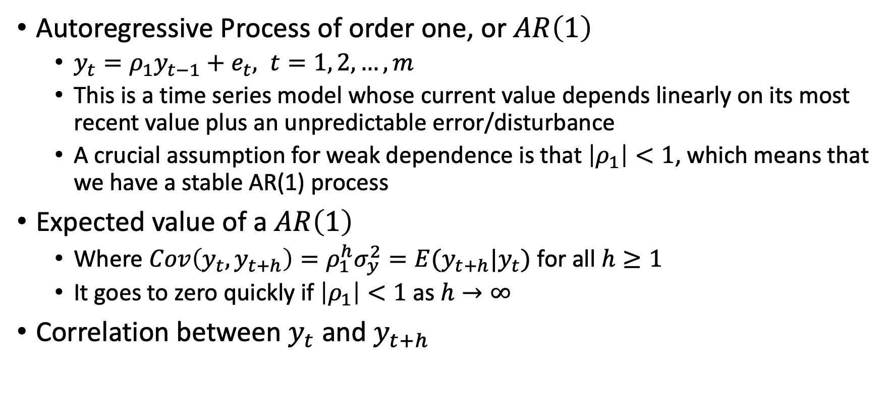
Examples of Weakly Dependent Time Series
Autoregressive Process of order one, or $AR\left(1\right)$
$y_{t}=ρ_{1}y_{t−1}+e_{t}, t=1, 2, …, m$
This is a time series model whose current value depends linearly on its most recent value plus an unpredictable error/disturbance
A crucial assumption for weak dependence is that $\left|ρ_{1}\right|<1$, which means that we have a stable AR(1) process
Expected value of a $AR\left(1\right)$
Where $Cov\left(y_{t},y_{t+h}\right)=ρ_{1}^{h}σ_{y}^{2}=E(y_{t+h}|y_{t})$ for all $h≥1$
It goes to zero quickly if $\left|ρ_{1}\right|<1$ as $h→∞$
Correlation between $y_{t}$ and $y_{t+h}$
Notes:
Covariance stationary sequences can be characterized in terms of correlations: a covariance stationary times series is weakly dependent if the correlation between $x_{t}$ and $x_{t+h}$ goes to zero sufficiently quickly as $h→ ∞$

Slide 45
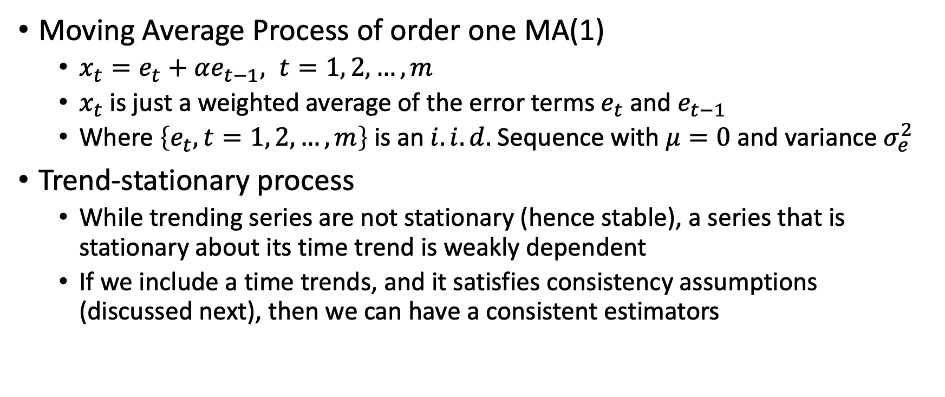
Examples of Weakly Dependent Time Series
Moving Average Process of order one MA(1)
$x_{t}=e_{t}+αe_{t−1}, t=1, 2, …, m$
$x_{t}$ is just a weighted average of the error terms $e_{t}$ and $e_{t−1}$
Where $\left\{e_{t}, t=1, 2, …, m\right\}$ is an $i.i.d.$ Sequence with $μ=0$ and variance $σ_{e}^{2}$
Trend-stationary process
While trending series are not stationary (hence stable), a series that is stationary about its time trend is weakly dependent
If we include a time trends, and it satisfies consistency assumptions (discussed next), then we can have a consistent estimators
Notes:
Covariance stationary sequences can be characterized in terms of correlations: a covariance stationary times series is weakly dependent if the correlation between $x_{t}$ and $x_{t+h}$ goes to zero sufficiently quickly as $h→ ∞$

Slide 46
Consistency Properties of OLS with Time Series

Slide 47
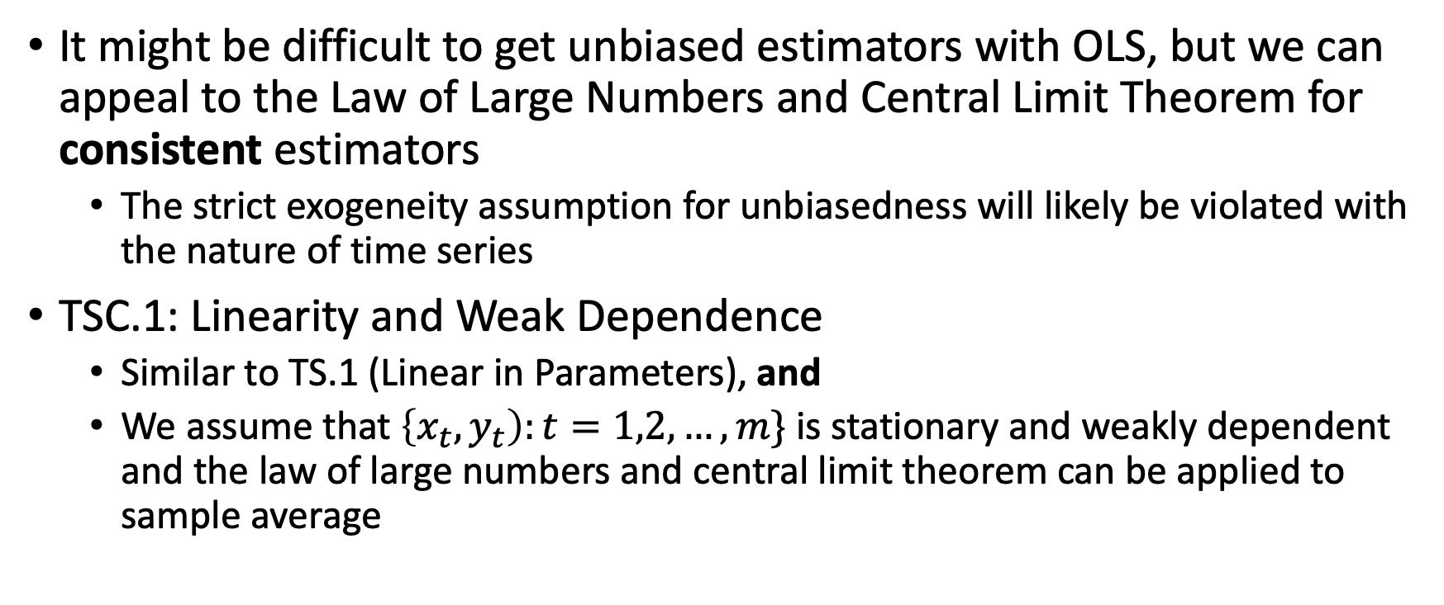
Asymptotic Properties of OLS with Time Series
It might be difficult to get unbiased estimators with OLS, but we can appeal to the Law of Large Numbers and Central Limit Theorem for consistent estimators
The strict exogeneity assumption for unbiasedness will likely be violated with the nature of time series
TSC.1: Linearity and Weak Dependence
Similar to TS.1 (Linear in Parameters), and
We assume that $\left\{x_{t},y_{t}\right):t=1,2,…,m\}$ is stationary and weakly dependent and the law of large numbers and central limit theorem can be applied to sample average

Slide 48
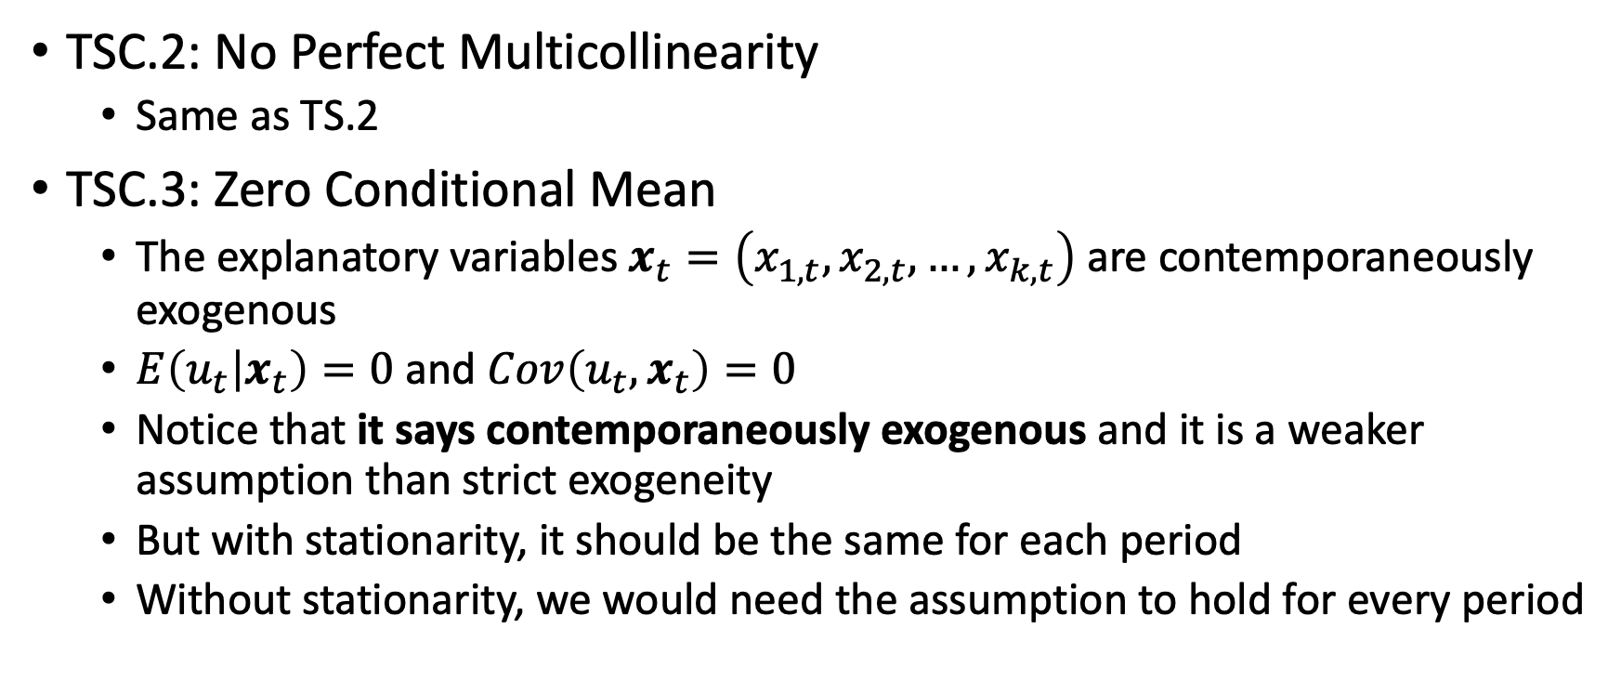
Asymptotic Properties of OLS with Time Series
TSC.2: No Perfect Multicollinearity
Same as TS.2
TSC.3: Zero Conditional Mean
The explanatory variables $x_{t}=\left(x_{1,t}, x_{2,t}, …, x_{k,t}\right)$ are contemporaneously exogenous
$E\left(u_{t} | x_{t}\right)=0$ and $Cov\left(u_{t},x_{t}\right)=0$
Notice that it says contemporaneously exogenous and it is a weaker assumption than strict exogeneity
But with stationarity, it should be the same for each period
Without stationarity, we would need the assumption to hold for every period

Slide 49
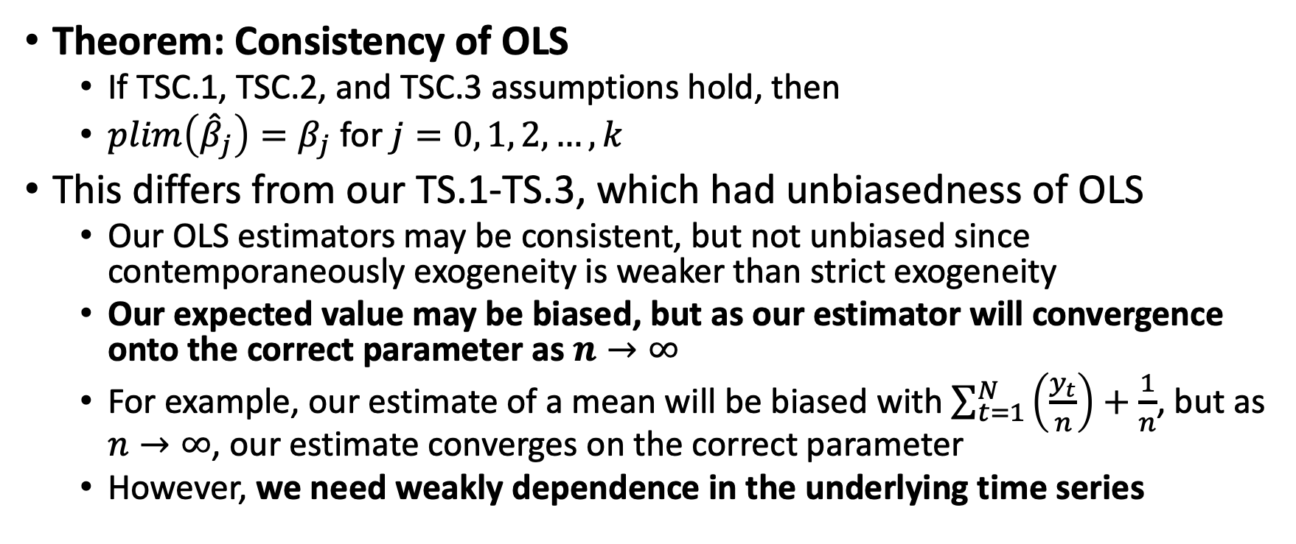
Asymptotic Properties of OLS with Time Series
Theorem: Consistency of OLS
If TSC.1, TSC.2, and TSC.3 assumptions hold, then
$plim\left({\hat{β}}_{j}\right)=β_{j}$ for $j=0, 1, 2,…,k$
This differs from our TS.1-TS.3, which had unbiasedness of OLS
Our OLS estimators may be consistent, but not unbiased since contemporaneously exogeneity is weaker than strict exogeneity
Our expected value may be biased, but as our estimator will convergence onto the correct parameter as $n→∞$
For example, our estimate of a mean will be biased with $\sum_{t=1}^{N}{\left(\frac{y_{t}}{n}\right)+\frac{1}{n}}$, but as $n→∞$, our estimate converges on the correct parameter
However, we need weakly dependence in the underlying time series

Slide 50
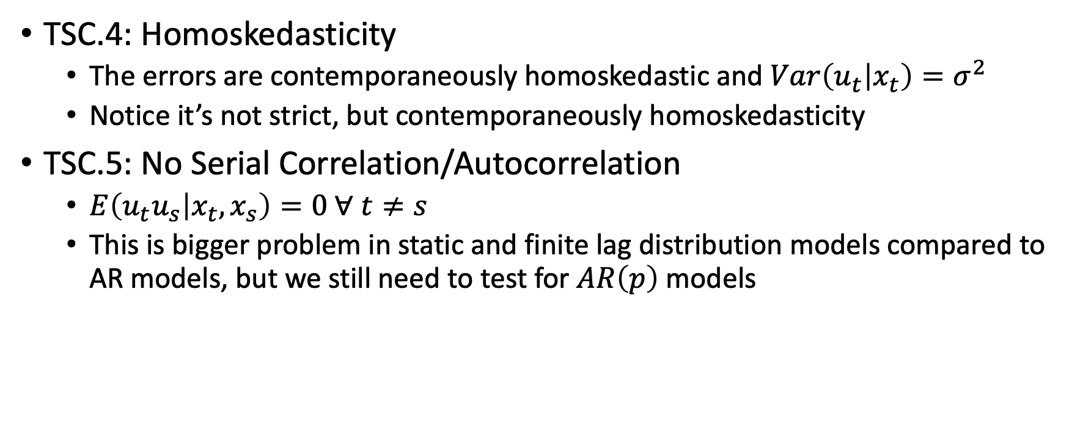
Asymptotic Properties of OLS with Time Series
TSC.4: Homoskedasticity
The errors are contemporaneously homoskedastic and $Var\left(u_{t} | x_{t}\right)=σ^{2}$
Notice it’s not strict, but contemporaneously homoskedasticity
TSC.5: No Serial Correlation/Autocorrelation
$E\left(u_{t}u_{s} | x_{t},x_{s}\right)=0 ∀ t≠s$
This is bigger problem in static and finite lag distribution models compared to AR models, but we still need to test for $AR\left(p\right)$ models

Slide 51
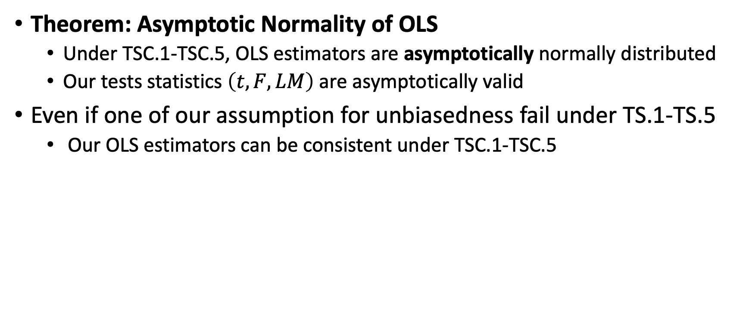
Asymptotic Properties of OLS with Time Series
Theorem: Asymptotic Normality of OLS
Under TSC.1-TSC.5, OLS estimators are asymptotically normally distributed
Our tests statistics $\left(t, F, LM\right)$ are asymptotically valid
Even if one of our assumption for unbiasedness fail under TS.1-TS.5
Our OLS estimators can be consistent under TSC.1-TSC.5

Slide 52
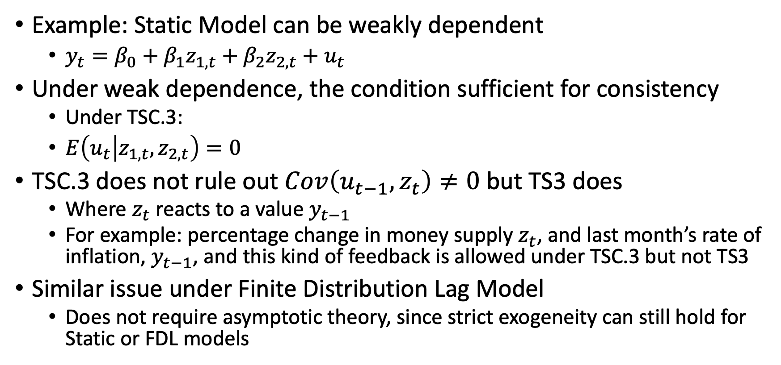
Asymptotic Properties of OLS with Time Series
Example: Static Model can be weakly dependent
$y_{t}=β_{0}+β_{1}z_{1,t}+β_{2}z_{2,t}+u_{t}$
Under weak dependence, the condition sufficient for consistency
Under TSC.3:
$E\left(u_{t} | z_{1,t},z_{2,t}\right)=0$
TSC.3 does not rule out $Cov\left(u_{t−1},z_{t}\right)≠0$ but TS3 does
Where $z_{t}$ reacts to a value $y_{t−1}$
For example: percentage change in money supply $z_{t}$, and last month’s rate of inflation, $y_{t−1}$, and this kind of feedback is allowed under TSC.3 but not TS3
Similar issue under Finite Distribution Lag Model
Does not require asymptotic theory, since strict exogeneity can still hold for Static or FDL models

Slide 53
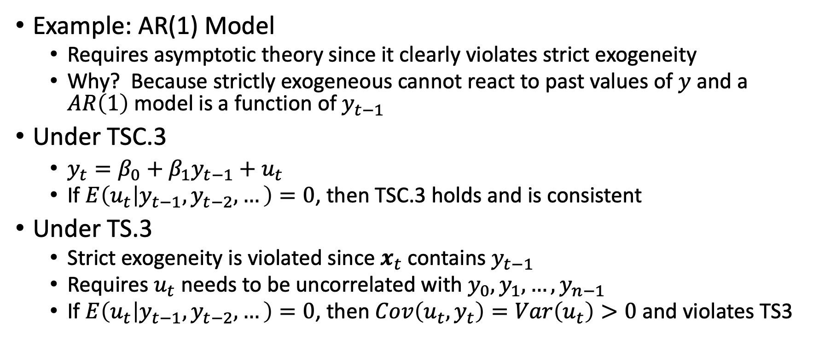
Asymptotic Properties of OLS with Time Series
Example: AR(1) Model
Requires asymptotic theory since it clearly violates strict exogeneity
Why? Because strictly exogeneous cannot react to past values of $y$ and a $AR\left(1\right)$ model is a function of $y_{t−1}$
Under TSC.3
$y_{t}=β_{0}+β_{1}y_{t−1}+u_{t}$
If $E\left(u_{t} | y_{t−1},y_{t−2},…\right)=0$, then TSC.3 holds and is consistent
Under TS.3
Strict exogeneity is violated since $x_{t}$ contains $y_{t−1}$
Requires $u_{t}$ needs to be uncorrelated with $y_{0}, y_{1}, …, y_{n−1}$
If $E\left(u_{t} | y_{t−1},y_{t−2},…\right)=0$, then $Cov\left(u_{t},y_{t}\right)=Var\left(u_{t}\right)>0$ and violates TS3

Slide 54
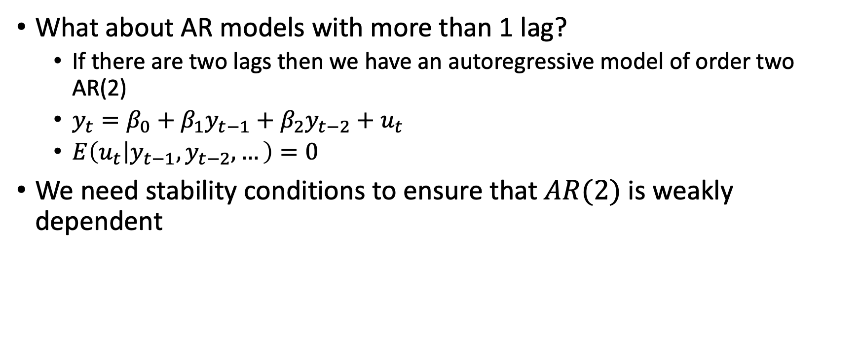
Asymptotic Properties of OLS with Time Series
What about AR models with more than 1 lag?
If there are two lags then we have an autoregressive model of order two AR(2)
$y_{t}=β_{0}+β_{1}y_{t−1}+β_{2}y_{t−2}+u_{t}$
$E\left(u_{t} | y_{t−1},y_{t−2},…\right)=0$
We need stability conditions to ensure that $AR(2)$ is weakly dependent

Slide 55
Stata

Slide 56
Highly Persistent Times Series

Slide 57
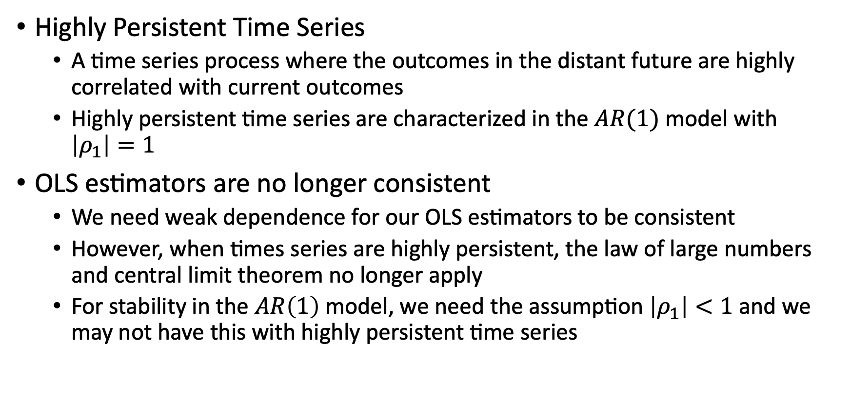
Highly Persistent Time Series
Highly Persistent Time Series
A time series process where the outcomes in the distant future are highly correlated with current outcomes
Highly persistent time series are characterized in the $AR(1)$ model with $\left|ρ_{1}\right|=1$
OLS estimators are no longer consistent
We need weak dependence for our OLS estimators to be consistent
However, when times series are highly persistent, the law of large numbers and central limit theorem no longer apply
For stability in the $AR\left(1\right)$ model, we need the assumption $\left|ρ_{1}\right|<1$ and we may not have this with highly persistent time series

Slide 58
Highly Persistent Time Series
Types of Highly Persistent Time Series
Random Walk
Unit Root Process
Random Walk with Drift
What to do?
We can use transformations for use highly persistent times series
We’ll turn a highly persistent time series into a weakly dependent one

Slide 59
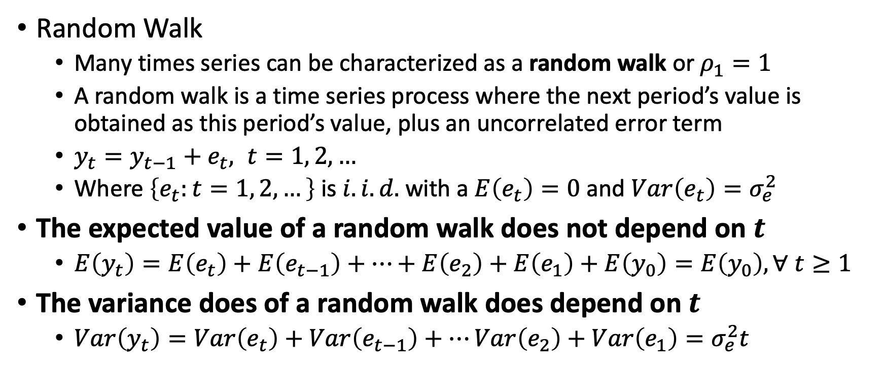
Highly Persistent Time Series
Random Walk
Many times series can be characterized as a random walk or $ρ_{1}=1$
A random walk is a time series process where the next period’s value is obtained as this period’s value, plus an uncorrelated error term
$y_{t}=y_{t−1}+e_{t}, t=1, 2, …$
Where $\left\{e_{t}:t=1, 2, …\right\}$ is $i.i.d.$ with a $E\left(e_{t}\right)=0$ and $Var\left(e_{t}\right)=σ_{e}^{2}$
The expected value of a random walk does not depend on $t$
$E\left(y_{t}\right)=E\left(e_{t}\right)+E\left(e_{t−1}\right)+…+E\left(e_{2}\right)+E\left(e_{1}\right)+E\left(y_{0}\right)=E\left(y_{0}\right), ∀ t≥1$
The variance does of a random walk does depend on $t$
$Var\left(y_{t}\right)=Var\left(e_{t}\right)+Var\left(e_{t−1}\right)+…Var\left(e_{2}\right)+Var\left(e_{1}\right)=σ_{e}^{2}t$

Slide 60
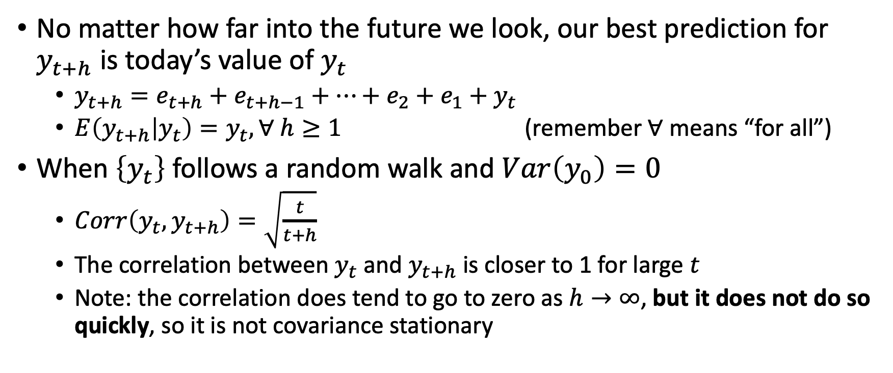
Highly Persistent Time Series
No matter how far into the future we look, our best prediction for $y_{t+h}$ is today’s value of $y_{t}$
$y_{t+h}=e_{t+h}+e_{t+h−1}+…+e_{2}+e_{1}+y_{t}$
$E\left(y_{t+h} | y_{t}\right)=y_{t}, ∀ h≥1$ (remember $∀$ means “for all”)
When $\left\{y_{t}\right\}$ follows a random walk and $Var\left(y_{0}\right)=0$
$Corr\left(y_{t},y_{t+h}\right)=\sqrt{\frac{t}{t+h}}$
The correlation between $y_{t}$ and $y_{t+h}$ is closer to 1 for large $t$
Note: the correlation does tend to go to zero as $h→∞$, but it does not do so quickly, so it is not covariance stationary

Slide 61
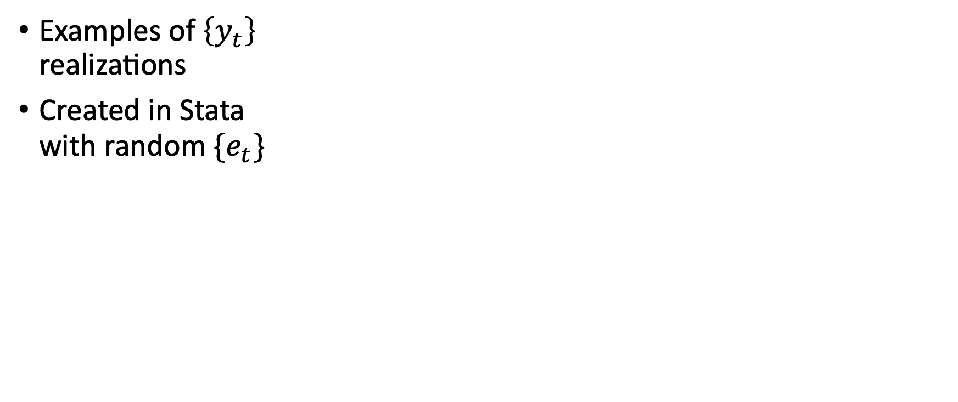
Highly Persistent Time Series
Examples of $\left\{y_{t}\right\}$ realizations
Created in Stata with random $\{e_{t}\}$

Slide 62
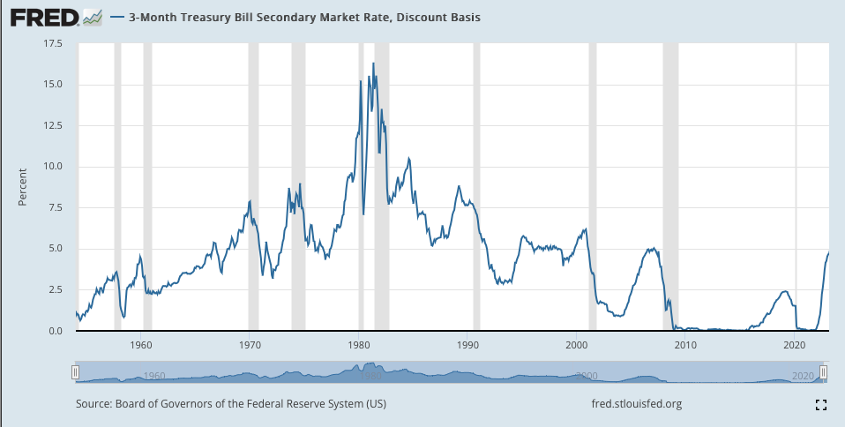
Highly Persistent Time Series
Example: 3-month T-Bill

Slide 63
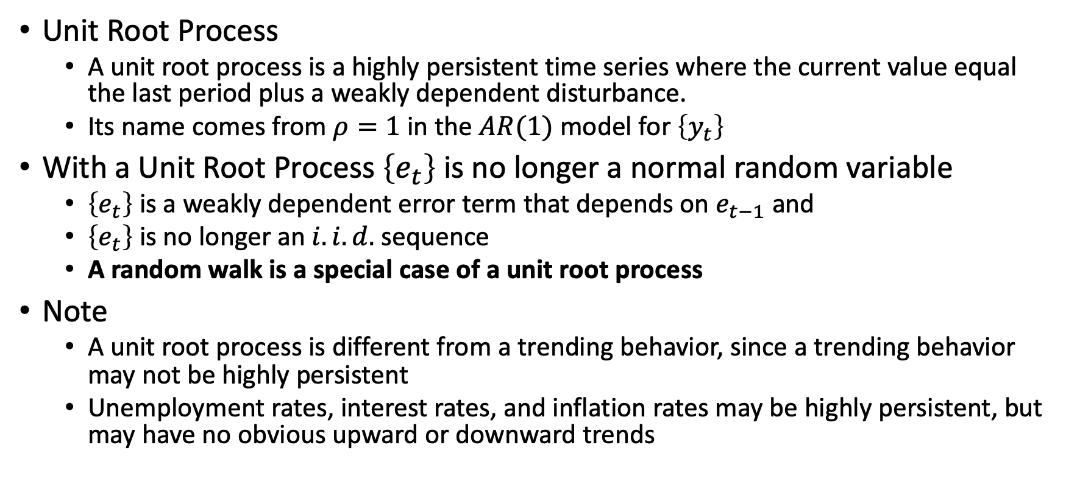
Highly Persistent Time Series
Unit Root Process
A unit root process is a highly persistent time series where the current value equal the last period plus a weakly dependent disturbance.
Its name comes from $ρ=1$ in the $AR(1)$ model for $\left\{y_{t}\right\}$
With a Unit Root Process $\left\{e_{t}\right\}$ is no longer a normal random variable
$\left\{e_{t}\right\}$ is a weakly dependent error term that depends on $e_{t−1}$ and
$\left\{e_{t}\right\}$ is no longer an $i.i.d.$ sequence
A random walk is a special case of a unit root process
Note
A unit root process is different from a trending behavior, since a trending behavior may not be highly persistent
Unemployment rates, interest rates, and inflation rates may be highly persistent, but may have no obvious upward or downward trends

Slide 64
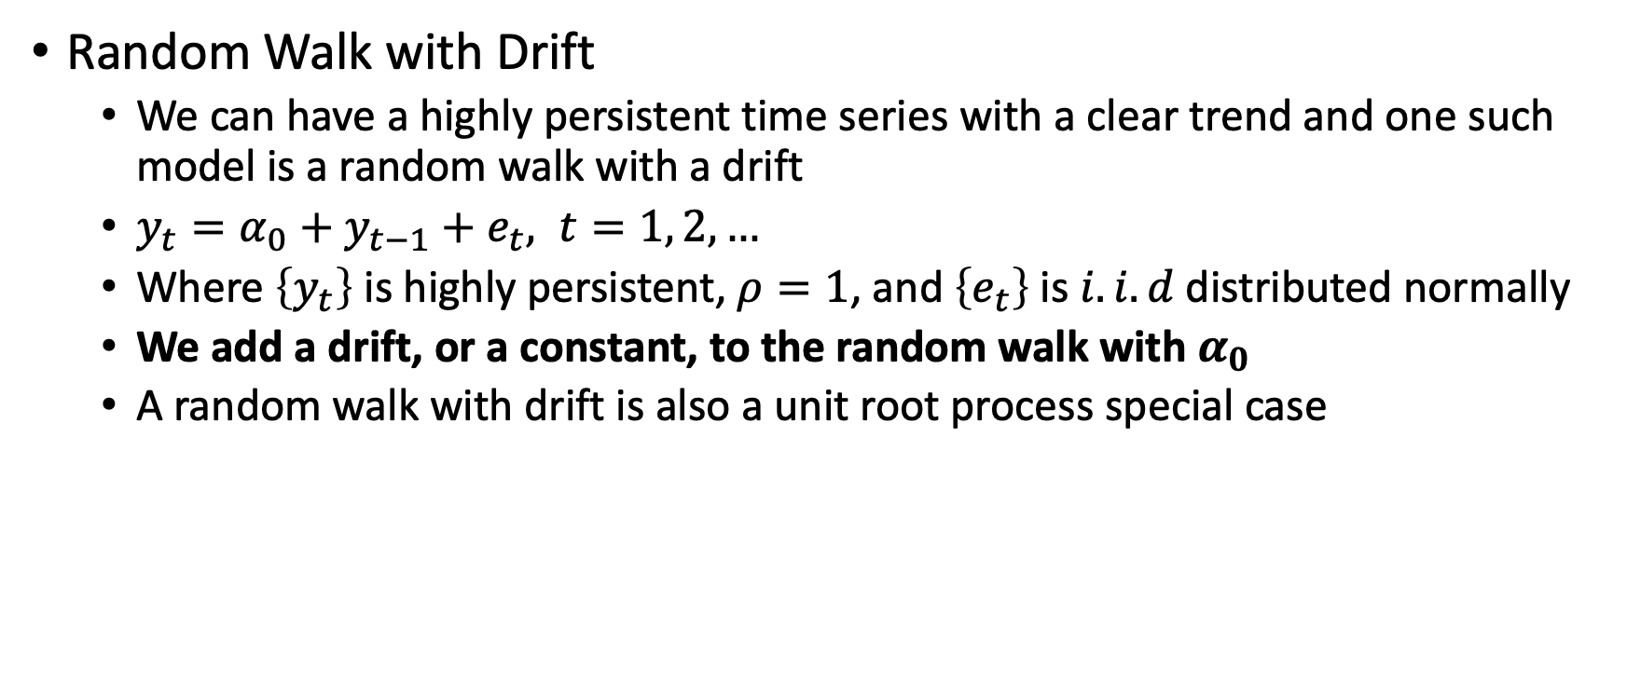
Highly Persistent Time Series
Random Walk with Drift
We can have a highly persistent time series with a clear trend and one such model is a random walk with a drift
$y_{t}=α_{0}+y_{t−1}+e_{t}, t=1, 2, …$
Where $\left\{y_{t}\right\}$ is highly persistent, $ρ=1$, and $\left\{e_{t}\right\}$ is $i.i.d$ distributed normally
We add a drift, or a constant, to the random walk with $α_{0}$
A random walk with drift is also a unit root process special case

Slide 65
Highly Persistent Time Series
Random Walk with a Drift example from Stata

Slide 66
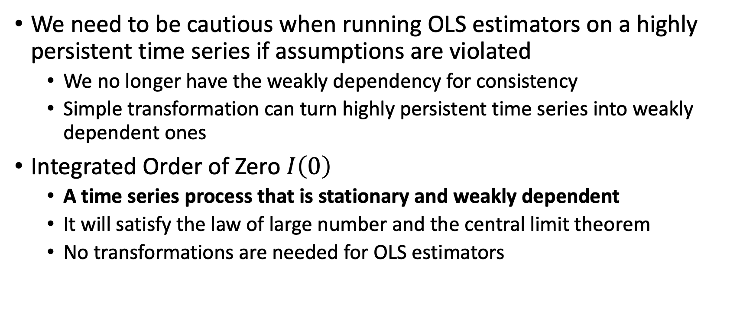
Transformations of Highly Persistent Time Series
We need to be cautious when running OLS estimators on a highly persistent time series if assumptions are violated
We no longer have the weakly dependency for consistency
Simple transformation can turn highly persistent time series into weakly dependent ones
Integrated Order of Zero $I\left(0\right)$
A time series process that is stationary and weakly dependent
It will satisfy the law of large number and the central limit theorem
No transformations are needed for OLS estimators

Slide 67
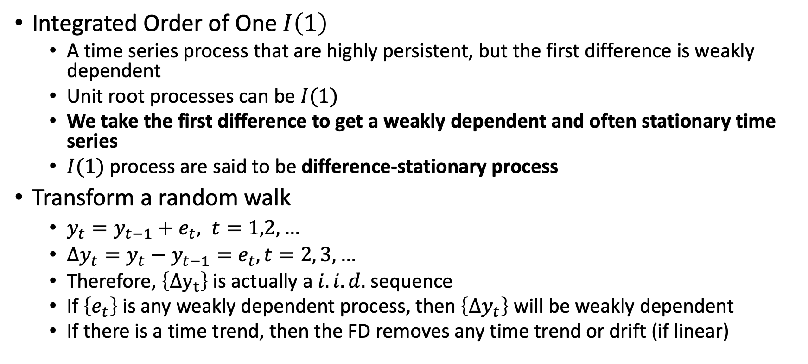
Transformations of Highly Persistent Time Series
Integrated Order of One $I\left(1\right)$
A time series process that are highly persistent, but the first difference is weakly dependent
Unit root processes can be $I(1)$
We take the first difference to get a weakly dependent and often stationary time series
$I(1)$ process are said to be difference-stationary process
Transform a random walk
$y_{t}=y_{t−1}+e_{t}, t=1,2,…$
$Δy_{t}=y_{t}−y_{t−1}=e_{t}, t=2, 3,…$
Therefore, $\left\{Δy_{t}\right\}$ is actually a $i.i.d.$ sequence
If $\left\{e_{t}\right\}$ is any weakly dependent process, then $\left\{Δy_{t}\right\}$ will be weakly dependent
If there is a time trend, then the FD removes any time trend or drift (if linear)

Slide 68
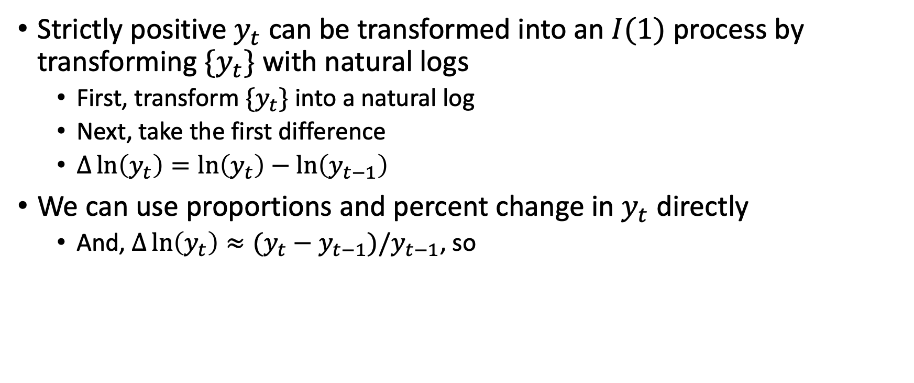
Transformations of Highly Persistent Time Series
Strictly positive $y_{t}$ can be transformed into an $I(1)$ process by transforming ${\{y}_{t}\}$ with natural logs
First, transform $\{y_{t}\}$ into a natural log
Next, take the first difference
$Δ\ln\left(y_{t}\right)=\ln\left(y_{t}\right)−\ln\left(y_{t−1}\right)$
We can use proportions and percent change in $y_{t}$ directly
And, $Δ\ln\left(y_{t}\right)≈(y_{t}−y_{t−1})/y_{t−1}$, so

Slide 69

Transformations of Highly Persistent Time Series
First difference can take care of time trends
$y_{t}=γ_{0}+γ_{1}t+v_{t}$
Where $E\left(v_{t}\right)=0$
$Δy_{t}=γ_{1}+Δv_{t}$
So, $E\left(Δy_{t}\right)=γ_{1}+E\left(Δv_{t}\right)=γ_{1}$
This also works when $\ln\left(y_{t}\right)$ follows a linear trend

Slide 70

Transformations of Highly Persistent Time Series
How do we know if a time series is $I(1)$?
If $\left|ρ_{1}\right|<1$, then we have a $I\left(0\right)$ series, but if $ρ_{1}=1$, then we have a $I\left(1\right)$ series
Informal Method
We can estimate the first order autocorrelation of $\left\{y_{t}\right\}$ or ${\hat{ρ}}_{1}$ and by the law of large numbers, ${\hat{ρ}}_{1}$ can be consistent, but not unbiased, estimate of $ρ_{1}$
It is difficult to use ${\hat{ρ}}_{1}$, since the estimator can have severe downward bias when $ρ_{1}=1$, but a rule of thumb is use FD when ${\hat{ρ}}_{1}>0.8$ or ${\hat{ρ}}_{1}>0.9$
Dickey-Fuller (DF) test for a unit root
If $H_{0}:ρ=1$ then our one-sided alternative is $H_{A}:ρ<1$
$Δy_{t}=α+θy_{t−1}+e_{t}$ where $θ=ρ−1$
We cannot use a $t$ distribution, we need to use a Dickey-Fuller Distribution
We can use the $t$-statistic against the Dickey-Fuller Distribution to test the hypothesis

Slide 71
Dynamically Complete Models

Slide 72

Dynamically Complete Models and Serial Correlation
Dynamically Complete Model
A time series model where no additional lags of either dependent or explanatory variables help to explain the mean of the dependent variable
Dynamically complete models should take care of the serial correlation
$AR(1)$ model under zero conditional mean
The errors $\left\{u_{t}\right\}$ must be serially uncorrelated if it is truly is a $AR\left(1\right)$ model
$AR\left(1\right)$ satisfy TSC.5 when $E\left(u_{t} | y_{t−1},y_{t−2},…\right)=0,$ such that
$E\left(u_{t}u_{s} | u_{s},y_{t−1},y_{s−1}\right)=u_{s} and E\left(u_{t} | y_{t−1},y_{s−1}\right)=0$
What about Static and Finite Distributed Lag Models?
Static and FDL models can satisfy TSC.5 if they are dynamically complete
Note:
Serial correlation could possibly be a sign that the model is mis-specified, but not always

Slide 73

Dynamically Complete Models and Serial Correlation
Dynamically Complete Static Model
We have a static model: $y_{t}=β_{0}+β_{1}z_{1}+u_{t}$
Which is similar to our panel data models so far
For consistency,
We need $E\left(u_{t} | z_{t}\right)=0$
Generally $\left\{u_{t}\right\}$will be serially correlated
However, if we condition $\left\{u_{t}\right\}$ on the dynamically complete model, then
$E\left(u_{t} | z_{t}, y_{t−1},y_{t−2},…\right)=0$ then TSC.5 holds
Our dynamically complete static model
$E\left(y_{t} | z_{t},y_{t−1},y_{t−2},…\right)=E\left(y_{t} | z_{t}\right)=β_{0}+β_{1}z_{1}$
If our assumption $E\left(u_{t} | z_{t}, y_{t−1},y_{t−2},…\right)=0$ holds, then it says that once $z_{t}$ has been controlled, no lags of $y$ or $z$ explain the current $y$

Slide 74

Dynamically Complete Models and Serial Correlation
Dynamically Complete Finite Distribution Lag Model
$y_{t}=β_{0}+β_{1}z_{1}+β_{2}z_{t−1}+β_{3}z_{t−2}+u_{t}$
If the model captures all of the distributed lag dynamics then
$E\left(y_{t} | z_{t}, z_{t−1}, z_{t−2},z_{t−3},…\right)=E\left(y_{t}\right|z_{t},z_{t−1},z_{t−2})$
Only two lags matter
If we assume that no lags of $y$ or no lags of $z$ affect $y_{t}$, then it is dynamically complete and no serial correlation affects the estimators
$E\left(y_{t} | z_{t},y_{t−1},z_{t−1},y_{t−2},z_{t−2},…\right)=E(y_{t}|z_{t}, z_{t−1},z_{t−2}$)

Slide 75

Dynamically Complete Models and Serial Correlation
General Dynamically Complete Model
$y_{t}=β_{0}+β_{1}z_{t}+β_{2}y_{t−1}+β_{3}z_{t−1}+u_{t}$
If $x_{t}$ captures all dependent and explanatory lags that explain current $y$
$y_{t}=β_{0}+x^{′}β+u_{t}$
It is dynamically complete if all of the relevant lags of $z$ and $y$ are in $x$
$E\left(u_{t} | z_{t},y_{t−1},z_{t−1},y_{t−2},…\right)=0$
$E\left(y_{t} | z_{t},y_{t−1},z_{t−1},y_{t−2},…\right)=E(y_{t}|x)$
Sequential Exogeneity
In panel or time series models, the error term in the current period has zero conditional mean on all current or past explanatory variables
$E\left(u_{t} | x_{t},x_{t−1},…\right)=E\left(u_{t}\right)=0, t=1,2,…$
Dynamically completeness and sequential exogeneity have the same conditions

Slide 76
Serial Correlation in Time Series

Slide 77

OLS estimators with Serial Correlation
Unbiasedness and Consistency
Even if there is serial correlation, our OLS estimators will be unbiased with strict exogeneity and consistent contemporaneous exogeneity and weak dependence
Efficiency and Inference
However, if serial correlation (and/or heteroskedasticity) will make the OLS estimators no longer BLUE with an $AR(1)$ model with weak dependency
Without Serial Correlation with TS1-TS5 satisfied
$Var\left(\hat{β}\right)=σ^{2}/SST_{x}$
With Serial Correlation with TS1-TS4 satisfied
$Var\left(\hat{β}\right)=$ $\frac{σ^{2}}{SST_{x}}+2\left(\frac{σ^{2}}{SST_{x}^{2}}\right)Σ_{t=1}^{n−1}Σ_{j=1}^{n−1}ρ^{j}x_{t}x_{t+j}$

Slide 78

OLS estimators with Serial Correlation
With Serial Correlation with TS1-TS4 satisfied
$Var\left(\hat{β}\right)=$ $\frac{σ^{2}}{SST_{x}}+2\left(\frac{σ^{2}}{SST_{x}^{2}}\right)Σ_{t=1}^{n−1}Σ_{j=1}^{n−1}ρ^{j}x_{t}x_{t+j}$
Notice that when $ρ^{j}=0$, the variance is unbiased
Positive serial correlation
Positive serial correlation is the most common type
$0<ρ<1$
OLS understates $Var\left(\hat{β}\right)$
Negative serial correlation
$−1<ρ<0$ and $ρ^{j}$ is negative when $j$ is odd and positive when even
OLS overstates $Var\left(\hat{β}\right)$
Our typical tests are invalid when serial correlation is present

Slide 79

Testing for Serial Correlation
$t$-test for $AR\left(1\right)$ with strictly exogeneous regressors
The most popular and easiest test
Durbin-Watson Test
Another $AR\left(1\right)$ test
Testing $AR\left(1\right)$ without strictly exogeneous regressors
Durbin’s alternative statistic without the need for strict exogeneity
Testing for higher order serial correlation
We can test beyond 1 lag using an $F$-test for $AR(q)$ models

Slide 80

Testing for Serial Correlation
$t$-test for $AR\left(1\right)$ with strictly exogeneous regressors
The most popular and easiest test
$u_{t}={ρu}_{t−1}+e_{t}, t=1, 2, …$
Our null hypothesis: $H_{0}:ρ=0$ or no serial correlation
We assume strict exogeneity $E\left(u_{t} | x_{t},x_{s}\right)=0, j≠s$
And $e_{t}$ of the $AR\left(1\right)$ model is 0: $E\left(e_{t} | u_{t−1},u_{t−2},…\right)=0$
And the variance of $e_{t}$ is constant: $Var\left(e_{t} | u_{t−1}\right)=Var\left(e_{t}\right)=σ_{e}^{2}$
Or, $\left\{e_{t}\right\}$ is $i.i.d.$ Sequence
We don’t know $u_{t}$
We can use the estimated ${\hat{u}}_{t}$ to estimate $ρ$

Slide 81

Testing for Serial Correlation
We have used $t$-test for $AR\left(1\right)$ with strictly exogeneous regressors before
Estimate ${\hat{u}}_{t}$ after the regression of $y_{t}$ on $x_{t}$
Regress ${\hat{u}}_{t}$ on ${\hat{u}}_{t−1}$ without a constant to get an estimate of $\hat{ρ }$
Use the $t_{ρ}$ to test $H_{0}:ρ=0$
Note:
It’s possible to find statistical significance with a large enough sample
You may need to adjust for heteroskedastic-robust standard errors

Slide 82

Testing for Serial Correlation
Durban-Watson Test
Another test for $AR\left(1\right)$serial correlation that is based on OLS residuals
$DW=$ $\frac{{\sum_{t=2}^{n}{\left({\hat{u}}_{t}−{\hat{u}}_{t−1}\right)}}^{2}}{\sum_{t=1}^{n}{{\hat{u}}_{t}^{2}}}≈2\left(1−\hat{ρ}\right)$
Due to issues with the distribution of the null, we need:
An upper bound $d_{U}$ and a lower bound $d_{L}$ as critical values
We need the sample size, and the $k$ number of regressors, and to choose a significance level
If $DW<d_{L}$ then we reject the null hypothesis and accept the alternative $H_{A}:ρ>0$
If $DW>d_{U}$, then we fail to reject the null hypothesis
If $d_{L}≤DW≤d_{U}$, the test is inconclusive
Note: this requires the full set of classical assumptions including normality in the error term
If any fail, they can lead to a wide inconclusive region; Wooldridge prefers the $t$ test

Slide 83

Testing for Serial Correlation
Problems with the prior two tests
If there is a lack of strict exogeneity, then the $t$-test and $DW$-test are invalid
Durbin’s alternative statistic
Is valid when strict exogeneity is not present
Regress $y_{t}$ on $x_{t}$ and estimate the residuals, ${\hat{u}}_{t−1}$ (include the intercept)
Regress $u_{t}$ on $x_{t}$ and ${\hat{u}}_{t−1}$ to obtain $\hat{ρ}$ and the $t$-statistic $t_{ρ}$
Use $t_{ρ}$ to test $H_{0}:ρ=0$
We can use heteroskedastic-robust standard errors, as well

Slide 84

Testing for Serial Correlation
Testing for Higher Order Serial Correlation
We can extend our tests for serial correlation for $q$ number of lags easily
For example, an $AR(2)$ model, but it can be extended to $AR(q)$
Testing for second order serial correlation
$H_{0}:ρ_{1}=0,ρ_{2}=0$
$u_{t}=ρ_{1}u_{t−1}+ρ_{2}u_{t−2}+e_{t}$
We regress $y_{t}$ on $x_{t}$ and obtain the residual ${\hat{u}}_{t}$
Regress ${\hat{u}}_{t}$ on $x_{t}$, $u_{t−1}$, and $u_{t−2}$
Obtain the $F$-statistic for joint significance of ${\hat{u}}_{t−1}$ and ${\hat{u}}_{t−2}$
If there are quarterly or seasonal data
We should test serial correlation for quarterly seasonally unadjusted data
$u_{t}=ρ_{4}u_{t−4}+e_{t}$
Regress ${\hat{u}}_{t}$ on ${\hat{u}}_{t−4}, ∀ t=5,…,n$

Slide 85
Correcting for Serial Correlation
Difference ways to take care of serial correlation
Correcting for Serial Correlation with Strictly Exogenous Regressors
Quasi-differenced data and Feasible Generalized Least Squares
Cochrane-Orcutt (CO) estimation
Prais-Winsten (PW) estimation
Problems occur when regressors are not strict exogeneous
Differencing
Go back to the Panel Data discussion on first-differencing
We can use this to take care of unit roots, but also serial correlation
Serial Correlation-Robust Inference
Adjust errors to account for serial correlation similar to heteroskedasticity

Slide 86

Correcting for Serial Correlation
We can quasi-difference transform our equation to eliminate serial correlation with Strictly Exogenous Regressors
If our model satisfies TS.1-TS.4, we relax our serial correlation assumption (TS.5), and our error term follows an $AR\left(1\right)$ model
$u_{t}=ρu_{t−1}+e_{t}$ and $e_{t}=u_{t}−{ρu}_{t−1}$
Our variance of the error term becomes
$Var\left(u_{t}\right)=σ_{e}^{2}/(1−ρ^{2})$
When $t≥2$, multiple the lag by $ρ$ and subtract the two periods
$y_{t}−ρy_{t−1}=\left(1−ρ\right)β_{0}+β_{1}\left(x_{t}−ρx_{t−1}\right)+e_{t}, t≥2$
${\tilde{y}}_{t}=\left(1−ρ\right)β_{0}+β_{1}{\tilde{x}}_{t}+e_{t}, t≥2$
When $t=1$, multiple by ${\left(1−ρ^{2}\right)}^{1/2}$
${\tilde{y}}_{1}={\left(1−ρ^{2}\right)}^{1/2}β_{0}+β_{1}{\tilde{x}}_{1}+{\tilde{u}}_{1}, t=1$
We can combine the two equations for BLUE estimators of $β_{0}$ and $β_{1}$

Slide 87

Correcting for Serial Correlation
Quasi-differenced data can be estimated with a Feasible Generalized Least Squares (FGLS)
Cochrane-Orcutt (OC) estimation uses FGLS without the first observation
Prais-Winsten (PW) uses all observation
OLS and FGLS
FGLS requires strict exogeneity, which is tough to satisfy, PLUS the sum of $x_{t+1}$ and $x_{t−1}$ needs to be uncorrelated with $u_{t}$ for FGLS to be consistent
$Cov(\left(x_{t+1}+x_{t−1}),u_{t}\right)=0$
If FGLS fails these assumptions, then it is inconsistent
OLS only requires contemporaneous exogeneity instead of strict exogeneity for consistency, while it might not be as efficient, it is consistent

Slide 88

Correcting for Serial Correlation
Differencing and Serial Correlation
We can use first differencing to transform highly persistent data into weakly dependent and use it to take care of serial correlation in these situations
$y_{t}=β_{0}+β_{1}x_{t}+u_{t}, t=1, 2, …$
We can use differencing if $\left\{u_{t}\right\}$ follows an $AR\left(1\right)$ process
$Δy_{t}=β_{1}Δx_{t}+Δu_{t}, t=1, 2, …$
If there is a random walk then $Δu_{t}$ will be serially uncorrelated
Even if $\left\{u_{t}\right\}$ does not follow a random walk where $ρ=1$ and $\left\{e_{t}\right\}$ is $i.i.d.,$
If $ρ$ is positive and large, then the first difference can take care of most of the serial correlation
Likely a better method than FGLS which has strong assumption requirements

Slide 89

Serial Correlation Robust Inference
Serial correlation-robust standard errors
This is an estimator that is asymptotically valid regardless of serial correlation
We may want to adjust the OLS standard errors instead of using FGLS, due to multiple strict exogeneity requirements makes and the errors follow an $AR\left(1\right)$ model
We can adjust the standard errors similar to heteroskedasticity
You can use SC-robust standard errors after a transformation
Problems
Unlike heteroskedastic-robust standard errors, this SC-robust standard errors may behave poorly when there is a lot of SC and small sample size
OLS can be very inefficient in small sample size
If serial correlation is substantial, then consider quasi-differencing

Slide 90

Final Note on Serial Correlation Correction
When we have panel data (Large $N$ with small $T$)
Cluster your standard errors
When ($N$ is small or 1 with a large $T$)
See if your time series is an $I(1)$ process, and if so take the first difference
If your time series satisfies the quasi-difference assumption, then consider the Prais-Winsten or Cochran-Orcutt estimator
If your time series does not satisfy the quasi-difference assumption, but your $T$ is sufficiently large, then use Newey Heteroskedastic Autocorrelation Correction standard errors
Don’t forget to use a sensitivity analysis

Slide 91
Forecasting

Slide 92

Forecasting
We change directions for forecasting
We are concerned about predicting rather than estimating causal or structural models – more machine learning realm
Goal: Minimize the Root Mean Squared Error or Mean Absolute Error
Information Set $I_{t}$
This is the data or information we can observe at time $t$ or prior for $y_{t}$ and $x_{t}$
We combine this information in innumerable ways to forecast $y_{t+1}$
Forecast Error
Loss is associated with forecast error, $e_{t+1}$ and $e_{t+1}=y_{t+1}−f_{t}$
Where $f_{t}$ is the one-step-ahead forecast (kind of like $y_{t+1}−{\hat{y}}_{t+1}=e_{t+1}$)
We measure $e_{t+1}$ once we observe $y_{t+1}$
We can use our squared error, $e_{t+1}^{2}$, or absolute value of the prediction error $\left|e_{t+1}\right|$ as a measure of loss or loss function

Slide 93

Forecasting
We need a criterion for choosing $f_{t}$ based on information at time $t$ to forecast $y_{t+1}$
At time $t$, we don’t know $e_{t+1}$ since it is a random variable given $y_{t+1}$ is a random variable
Minimize the expected squared forecast error given $I_{t}$ or information at $t$
$E\left(e_{t+1}^{2} | I_{t}\right)=E\left[{\left(y_{t+1}−f_{t}\right)}^{2} | I_{t}\right]$
Conditional expectation $E\left(y_{t+1} | I_{t}\right)$ minimizes the expected squared forecast error
Examples of times series where the conditional expectation is easy to obtain
A martingale process $\{y_{t}\}$ is $E\left(y_{t+1}\right|y_{t}, y_{t−1}, …,y_{0})=y_{t}, ∀ t≥0$
The predicted values of $y_{t+1}$ is always the value of $y_{t}$
An exponential smoothing process were weights of lags of $y$ go to 0
$E\left(y_{t+1} | I_{t}\right)=αy_{t}+α\left(1−α\right)y_{t−1}+α{\left(1−α\right)}^{t}y_{0}, 0<α<1$

Slide 94
Types of Regression Models Used for Forecasting
Types of Regression Models Used
Conditional Forecast
Unconditional Forecast
One-Step-Ahead Forecasting
Multiple-Step-Ahead Forecasting

Slide 95

Types of Regression Models Used for Forecasting
Conditional Forecasting
Suppose we have a simple static model $y_{t}=β_{0}+β_{1}z_{t}+u_{t}$
Suppose we know parameters $β_{0}$ and $β_{1}$ and $y_{t+1}=β_{0}+β_{1}z_{t+1}+u_{t+1}$
If $z_{t+1}$ is known at time $t$ as an element of $I_{t}$ and $E\left(u_{t+1} | I_{t}\right)=0$, then
$E\left(y_{t+1} | I_{t}\right)=β_{0}+β_{1}z_{t+1}$
Our conditional forecast model is $β_{0}+β_{1}z_{t+1}$, since it is conditional on knowing $z_{t+1}$ at time $t$
Problems
$E\left(u_{t+1} | I_{t}\right)=0$ means that $\left\{u_{t}\right\}$ cannot contain serial correlation
We may not know future value of $z_{t+1}$, but sometimes we have data on the explanatory variable before the dependent variable is published

Slide 96

Types of Regression Models Used for Forecasting
Unconditional Forecasting
If $z_{t+1}$ is not known at time $t$, we cannot include it and
$E\left(y_{t+1} | I_{t}\right)=β_{0}+β_{1}E\left(z_{t+1} | I_{t}\right)$
We have to forecast $z_{t+1}$ first, and then forecast $y_{t+1}$
Note: $y_{t+1}$ is still conditional on $I_{t}$, so the name is a bit misleading
These past two forecasting models are based on static models
Vector Autoregressive (VAR) model
A VAR model is a model of two or more time series where each variable is modeled as a linear function of past values of all variables, plus error terms that have zero means given all past values
We may have lags of $y$ and $z$in our forecasts to predict future values $y$
$y_{t}=β_{0}+α_{1}y_{t−1}+γ_{1}z_{t−1}+u_{t}$ is an example of a VAR model
Where $E\left(u_{t} | I_{t−1}\right)=0$
Think of VAR as multivariate and AR as lags of $y$ only

Slide 97

Types of Regression Models Used for Forecasting
One-Step-Ahead Forecasting
If we are interested in forecasting one period ahead at the end of our sample
Estimate a point forecast for $y_{t+1}$ with a sample size of $n$:
${\hat{f}}_{n}={\hat{δ}}_{0}+{\hat{α}}_{1}y_{n}+{\hat{γ}}_{1}z_{n}$
Our forecast error is ${\hat{e}}_{n+1}=y_{n+1}−{\hat{f}}_{n}$
Estimate a forecast interval around ${\hat{f}}_{n}$
Estimate the standard error: $se\left({\hat{e}}_{n+1}\right)={\left\{{\left[se\left({\hat{f}}_{n}\right)\right]}^{2}+{\hat{σ}}^{2}\right\}}^{1/2}$
$se\left({\hat{f}}_{n}\right)$is the standard error of the forecast
$\hat{σ}$ is the standard error of the regression
Our 95% forecast interval is ${\hat{f}}_{n}±1.96 ∙se\left({\hat{e}}_{n+1}\right)$
Options for estimating $y_{n+2}$ with one-step-ahead
Wait until $y_{n+1}$ and $z_{n+1}$ actual data are available and then forecast $y_{n+2}$
Re-estimate your parameters using your forecasted $n+1$to forecast $y_{n+2}$

Slide 98

Types of Regression Models Used for Forecasting
Vector Autoregressive (VAR) models
If we have two series $y_{t}$ and $z_{t}$ a vector autoregression consists of
$y_{t}=δ_{0}+α_{1}y_{t−1}+γ_{1}z_{t−1}+α_{2}y_{t−2}+γ_{2}z_{t−2}+…$
$z_{t}=η_{0}+β_{1}y_{t−1}+ρ_{1}z_{t−1}+β_{2}y_{t−2}+ρ_{2}z_{t−2}+…$
Granger causality
We can test whether after controlling for past $y$, past $z$ helps forecast $y_{t}$
$E\left(y_{t} | I_{t−1}\right)≠E\left(y_{t} | J_{t−1}\right)$
Where $I_{t−1}$ consists information on $y$ and $z$, but $J_{t−1}$ only contains past $y$
Note: this differs conceptually from causal inference
E.g.: Use information on inflation and unemployment to forecast unemployment
We can test if $z$ does not Granger cause $y$ with $t$-tests and $F$-tests
We can add other lags $w_{t−1}, w_{t−2},…$ to $I_{t−1}$ and condition $z$ causes $y$ given $w$

Slide 99

Types of Regression Models Used for Forecasting
How do we compare our one-step-ahead forecasting models
In-sample criteria: using goodness-of-fit within sample
Out-of-sample criteria: criteria based on part of the sample that was not used in obtaining the parameter estimates
You should use out-of-sample criteria, where your training data $n$ is used to estimate the parameters, and your testing data $m$ is used to forecast
Let ${\hat{f}}_{n+h}$ be the one-step-ahead forecast of $y_{n+h+1}$ for $h=0,1,…,m−1$
The $m$ forecast errors are ${\hat{e}}_{n+h+1}=y_{n+h+1}−{\hat{f}}_{n+h}$
Measures to compare: minimize the errors
Root Mean Squared Error: $RMSE={\left(m^{−1}\sum_{h=0}^{m−1}{{\hat{e}}_{n+h+1}^{2}}\right)}^{1/2}$
Mean Absolute Error: $MAE=m^{−1}\sum_{h=0}^{m−1}{\left|{\hat{e}}_{n+h+1}^{2}\right|}$

Slide 100

Types of Regression Models Used for Forecasting
Forecasting Trending, Seasonal, and Integrated Processes
Some forecasts have trends, seasonality, or unit roots $\left(ρ=1\right)$
Trending processes
This is the simplest case where $\left\{y_{t}\right\}$ has a linear trend but is unpredictable around the trend
$y_{t}=α+βt+u_{t}$ and $E\left(u_{t} | I_{t−1}\right)=0, t=1, 2, …$
$I_{t−1}$ contains information on observations through time $t−1$ including past $y$
Forecast trending $y$
The forecast of $y_{n+h}$ at any time $n$ for any $h≥1$
$E\left(y_{n+h} | I_{n}\right)=α+β(n+h)$
The forecast error: $σ^{2}=Var\left(u_{t}\right)$ (assuming homoskedasticity)
Our forecast: ${\hat{f}}_{n+h}=\hat{α}+\hat{β}\left(n+h\right)$
We just plug in the time period corresponding to $y$ into the estimated trend function

Slide 101

Types of Regression Models Used for Forecasting
Trending process note:
We shouldn’t use trending forecasts for unit root or seasonality processes since it will lead to poor forecasts
Seasonality Forecasting
In our forecast model we can account for seasonality by adding binary monthly or quarterly binaries in whatever forecast process we have
Forecasting processes for unit roots
Unlike seasonality, forecasting processes with unit root requires more attention
A random walk with a drift: $y_{t+h}=βh+y_{t}+u_{t+1}+u_{t+2}+…+u_{t+h}$
We have two approaches to produce forecasts for $I\left(1\right)$ processes
1. Impose a unit root
2. Use a general AR or VAR model for $\left\{y_{t}\right\}$

Slide 102


Types of Regression Models Used for Forecasting for $I\left(1\right)$ Processes
1. Impose a unit root
For a one-step-ahead forecast, we model to forecast $Δy_{t+1}$
$y_{t+1}=Δy_{t+1}+y_{t}$, since $E\left(y_{t+1} | I_{t}\right)=E\left(Δy_{t+1} | I_{t}\right)+y_{t}$
Forecast: ${\hat{f}}_{n}={\hat{g}}_{n}+y_{n}$, where ${\hat{g}}_{n}=Δy_{n+1}$
We can use an AR or VAR model for $Δy_{n+1}$
2. Use a general AR or VAR model for $\left\{y_{t}\right\}$
E.g.: $y_{t}=α+ρ_{1}y_{t−1}+ρ_{2}y_{t−2}+u_{t}$ and $ρ_{1}+ρ_{2}=1$
Rearrange to obtain $Δy_{t}=α−ρ_{2}Δy_{t−1}+u_{t}$ for a stable $AR\left(1\right)$ model in the difference
Our model: $y_{t}=α+γy_{t−1}−ρ_{2}Δy_{t−1}+u_{t}$, where $ρ_{1}+ρ_{2}=γ$
The regression results will be similar to $y_{t}=α+ρ_{1}y_{t−1}+ρ_{2}y_{t−2}+u_{t}$, so we can use it directly

Slide 103
Stata

